Slide 1

The Duston School Family Guide
2026/7
Resilience, Respect and Aspiration

Slide 2

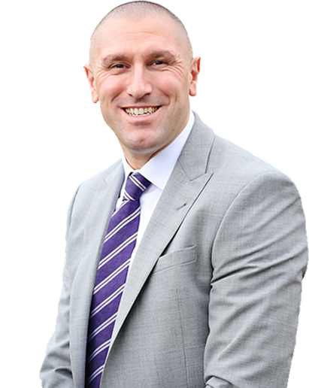
Principal’s Welcome
I thank you for selecting The Duston School and entrusting me and my staff with your child and their educational development. I warmly welcome you to The Duston School, which is part of The Luminara Education Trust. As Principal I take great pride in leading the school and supporting your child in their educational journey. The school mantra, ‘Knowledge itself is power,’ sits at the core of my own educational philosophy and influences all that we do. As a staffing body, we seek to get to know our pupils fully and the school community views itself as a family. I also firmly believe, as a parent myself, that if something is not good enough for my children then it certainly is not good enough for yours. As a parent your children are central to your life and, as a school, they carry just as much importance to us.
The Duston School’s educational philosophy is encapsulated by our mission statement, which is our aspiration for all of our pupils:
‘Our core aim is to help pupils climb the tree of knowledge so they can access University, Higher Education, Employment or an Apprenticeship and be the very best edit of themselves. All pupils are inspired to Dream – Believe – Achieve.’
We believe that education should provide our young people with both the currency and character to succeed. We work relentlessly to nurture our pupils to unlock and achieve their potential. Our pupils are actively encouraged to make a valuable contribution to society and thrive in a mutually supportive environment. All of our pupils are educated to enter the adult world with a strong moral compass, a real sense of resilience and to be armed with the key transferable skills that will allow them to succeed in an ever changing and fast paced globalised labour market. Our curriculum is broadly traditional in nature and built upon the premise that knowledge is the ultimate key to academic success. We endeavour to help our pupils gain the highest qualifications, acquire flexible life-long learning skills, and be ready to act responsibly as global citizens. We also promote the character development of our pupils, with a real focus on values and virtues that will support them through their school journey and into adult life.
A key factor in ensuring your child is successful at The Duston School is the level of overall co-operation and communication between the parental body and the school. We will endeavour to communicate successes, both holistically and on an individual pupil level, whenever we can. Underpinning all that we do are incredibly high expectations and we will, via an array of channels, directly communicate any issues with you. A crucial person in your child’s school career is their form tutor and I would encourage all parents to develop a professional working relationship with this key advocate for your child.
I look forward to meeting and welcoming you to the school.
Mr S Strickland Principal /CEO The Duston School

Slide 3
TDS Ethos & Values
At The Duston School a heavy emphasis is placed on the role of the tutor, who pupils meet every day. The tutor acts as the primary advocate for their tutees and, in many respects, acts as their Duston School parent. This is the person that parents/guardians will primarily have contact with to discuss their child's education.
The Duston School is built upon three core values: Resilience, Respect and Aspiration. We expect all of our pupils to exhibit and display these core traits in their daily life at the school, within the wider community and as they move into the next phase of their life once they leave our educational setting.
The Duston School community was canvassed to help create our school mantra, ‘Knowledge itself is power.’ This echoes the words of Kofi Annan, “Knowledge is power. Information is liberating. Education is the premise of progress, in every society, in every family.” Knowledge provides us with the power to help others, in a variety of ways. It is also something that is good for our own self-esteem. In addition, knowledge imbues us with authority and enables us to act and interact with others in a more moral way.
The Duston School is a highly successful establishment, that has consistently performed well on a national scale. Its successes are built upon a number of core foundations, notably:
1. A strong emphasis on a knowledge-rich, academically rigorous curriculum, where pupils are challenged and supported to achieve their best, with a clear focus on preparation for further education and life beyond school.
2. High standards of behaviour, built upon a consistent and structured approach. Classrooms are calm and orderly, creating an atmosphere where learning can thrive and every child can focus without distraction.
3. A supportive environment for children and staff, built upon a positive approach to inclusion. This is underpinned by strong approaches to SEND and our internal Positive Impact Centre.
4. The school places a strong emphasis on personal responsibility, resilience, and respect. Character education is embedded throughout the curriculum, preparing pupils to become thoughtful, engaged citizens.
5. A strong and clear vision, combined with consistent leadership. The Duston School is recognised for its model of clarity, structure, and ambition.
6. A commitment to high standards has created a culture of aspiration and excellence for all.

Slide 4

Character Education
Why is Character Education Important?
The choices an individual makes determines their future, and the purpose of developing good character is the ability to make good choices. Character allows us to flourish as individuals, and as a wider society. This is why the development of character, as well as achieving academic attainment, should be the purpose of education.
“Character becomes your destiny,” Lao Tzu, Philosopher
We believe that for a school to be rooted with Character it should be planned, intentional and fully embedded across the whole-school or organisation. We strive for character to be ‘taught,’ ‘caught’, and ‘sought.’
Where is The Duston School in our Character Journey?
In 2020 we started our journey on instilling a greater degree of Character within our pupils. We chose virtues that are relevant to our pupils.
Within the Secondary phase of TDS our pupils strive to show:
•Respect, Aspiration and Resilience
How we deliver Character Education at The Duston School?
The Duston School is founded on a clear mission statement and set of aims that inspire our pupils to ‘climb the tree of knowledge so they can access University, Higher Education, Employment or an Apprenticeship and be the very best edit of themselves.’ The school firmly believes in the power of over-communication and of visually displaying clear messaging across the entire school. The school’s mission statement is visible across the school.

Slide 5
The Transition Process
The Duston School has a comprehensive transition programme designed to ensure we are fully prepared to welcome your child into Year 7.
In the summer term, members of our Key Stage 3 team visit each primary school to meet Year 6 pupils and deliver a presentation introducing life at The Duston School. During these visits we also liaise with primary school staff to discuss each child in detail. In addition, our SENDCo visits schools to meet with staff and discuss pupils on the SEND register, allowing us to better understand and support their individual needs.
Our first transition opportunity, known as Factfinders, takes place in June. This day is aimed at pupils identified by their primary schools as benefiting from an additional visit. Pupils attend alongside a member of their primary school staff and spend the day in our Positive Impact Centre, working within a small group alongside other Year 6 pupils. During the day, pupils will meet key members of The Duston School staff and take part in a guided tour of the school.
The main transition days take place in July, when all incoming Year 7 pupils attend together. Upon arrival, pupils are placed into their tutor groups, where they are registered before being welcomed by the Principal in the main hall. Pupils then spend the morning with their form tutors, allowing them to build relationships, complete key activities, and receive important information about the school. This includes a school tour and a visit to the library.
Each tutor group is supported by a Year 9 or Year 10 student ambassador. These older pupils play an important role in helping new students navigate the school, accompanying them to lessons, lunch areas, and other facilities. They are also a valuable source of support and reassurance, answering questions and sharing their own experiences of school life.
In the afternoon, pupils take part in a range of subject lessons before returning to the hall at the end of the day for a reflection on their experiences. They attend again the following day, by which point many have already begun to form new friendships. During the transition period, parents are also invited into school for an evening presentation, where they will learn more about the school’s vision, culture and values and have the opportunity to meet key staff.
Then, in September, Year 7 pupils begin the term two days before Years 8–11 return. This provides them with valuable time to settle in and become familiar with the school environment while it is quieter. They will also continue to receive support from older student ambassadors who generously volunteer their time.
During the first term, we invite parents to attend an evening event to meet their child’s tutor and gain further insight into school life.

Slide 6
Teaching & Learning
At The Duston School we believe that powerful knowledge gives pupils the cultural literacy they need to become active citizens in society and further their personal aspirations and ambitions. Our core aim is to help pupils climb the tree of knowledge, so they can access university, higher education, employment or an apprenticeship.
In lessons there is a strong emphasis on retrieval practice, sequencing and interleaving, with the curriculum seen as a progression model. We strive for excellence in all that we do at The Duston School. We believe that every pupil, with a willingness to work hard and learn from their mistakes, can and will achieve great things. Our dedicated teachers use evidence-informed approaches to help motivate pupils to aim high and encourage every pupil to exceed their own expectations.
We are fortunate to have a high quality learning environment with the latest technologies to enhance the curriculum. We have purpose built ICT suites, a drama studio, music rooms, catering room and extensive sport facilities support our varied extra-curricular programme.
Our vibrant and welcoming library supports learning throughout the school and promotes improved literacy levels. It is well stocked, has additional ICT facilities and provides high quality services for everyone. We aim to engender a genuine love for reading and excitement about learning in every pupil.
Teachers benefit from excellent professional development at The Duston School so that they can continually develop their practice. Evaluating how well we are teaching and pupils are learning is done in a variety of ways, including lesson observation, pupil forums, and parental feedback; our Governing Body play an active role in this process. Pupil assessment data is analysed at every collection point in order to provide the necessary support and challenge to all pupils. Parents receive this information twice per year by letter along with one virtual parent consultation event each year.
In all lessons pupils must abide by the following three rules:
Respect the member of staff and other pupils, following all instructions without question or answering back (Respect)
Complete all work to the best of your ability, not distracting others (Aspiration)
Arrive on time to all lessons, with the correct uniform, equipment and homework (Resilience)

Slide 7
Curriculum
Curriculum at Key Stage 3
Our philosophy is that each pupil is entitled to a curriculum that prepares them for life’s opportunities, responsibilities and experiences. Our curriculum is designed to enable each individual to develop their maximum potential through stimulating and challenging pathways and by carefully monitoring each pupil’s social and academic progress. We believe that every pupil is capable of excellence and encourage each pupil to push themselves to achieve their potential.
Subject | Allocation
English | 4
Maths | 4
Science | 4
Geography | 2
History | 2
Spanish/ French | 2
Computing | 1
Music | 1
PE | 2
Religious Education | 1
Art (Including Graphics) | 1
Design Technology (Including Resistant Materials) | 1
Direct Instruction | 4*
Total | 25
*Direct Instruction is available for pupils who require additional focus on English and maths. Pupils will study DI for English and/or maths for up to 4 hours per subject. This replaces some Music/Geography/History /Drama/Spanish/ French lessons depending on the year group.
Curriculum at Key Stage 4
Our Key Stage 4 curriculum has a strong focus on the EBacc (English, Mathematics, Science, Languages, History and Geography) and a range of high value subject options. We have limited the number of GCSE subjects to be studied by our pupils to a maximum of eight. This will reduce the exam burden and help ensure that our pupils are given the time and opportunity to develop intellectually. The pathway approach also allows pupils that need additional support to be able to access this in order to be successful in their GCSEs or equivalent.
Subject | Allocation
English Literature & Language | 5
Maths & Statistics | 5
Double Science | 5
Pathway 1: Main | Pathway 2: Additional | Pathway 3: Support
Select one from: Geography, History, Spanish or French | Additional English and/or Maths | Support English
Select one from: Geography, History, Spanish, French, Computer Science, Hair & Beauty, Media Studies, Sport Studies or Psychology |  | Support Maths
One subject from the full suite of subjects (shown on the school website)
*The curriculum model is subject to change

Slide 8
Curriculum
Literacy
At The Duston School we recognise that high standards in literacy are fundamental to our pupils' success and well-being both at school and in life beyond. As such, we work to embed the learning and teaching of literacy skills in all subjects, and to raise awareness of their importance among all members of our community.
‘Literacy’ encompasses competence and confidence in reading, writing, speaking and listening, spelling, and the use of vocabulary; in its widest sense it represents the ability to function effectively in the wider world. We are committed to working with pupils and their parents/guardians to overcome any existing barriers to literacy and ensure that each pupil is equipped with a set of skills fit for the twenty-first century.
In order to achieve this for each pupil, we have robust systems in place for assessing the literacy levels of all our pupils and for identifying where additional support is necessary. In key stage 3, pupils who we identify as benefitting from literacy support take part in Direct Instruction lessons for literacy twice per week. These lessons are delivered by specialist teachers as part of a tried and tested programme to make rapid progress, so that pupils are able to confidently access the literacy demands of the whole curriculum.
We also recognise the essential place that reading holds in shaping our pupils as confident and knowledgeable citizens of the world. Pupils are encouraged to become regular visitors to our welcoming and well-stocked library, as well as continuing their reading as a habit in their everyday lives, via books they borrow both physically and electronically. All pupils read on a regular basis with their tutor group, enjoying a range of classic fiction titles across their time at the school, as well as a weekly academic article which they use as a springboard for interesting discussion about a range of cross-curricular and contemporary issues. Academic reading is also an integral part of learning across all subjects.
Reading is celebrated across the school through a range of events, guest speakers, prizes and competitions with pupils having regular opportunities to understand the inherent joy and rewards of reading for pleasure.
Modern Foreign Languages
The Modern Foreign Languages department seeks to enable pupils to confidently communicate in a foreign language, growing in knowledge and skills as well as awareness of our diverse society. We aim to engage pupils in languages with interactive classroom activities that cover a broad and balanced curriculum. Pupils are empowered in the four skills of language: listening, speaking, reading and writing. Pupils will study topics such as technology and media, future aspirations and personal well-being. Almost all pupils at TDS will study either French or Spanish at Key stage 3 and 4 for the full five years allowing them to reach their full potential in one language. The GCSE they gain in languages will form an essential part of the EBACC qualification.
Parents can support their children at home by establishing good habits for learning vocabulary and key texts. All pupils will bring home a knowledge organiser which will contain all the key language for that term.

Slide 9
Curriculum
Relationships and Sex Education (RSE) and PSHE
Relationships and Sex Education (RSE) and PSHE are covered in dedicated, weekly tutor time slots with your pupils' tutors, as well as additional time during Character Culture sessions on Mondays. Pupils follow a rigorously planned curriculum offer which meets all of the government statutory requirements in this area. Pupils will engage with outside speakers with topics such as mental health, relationships and sex education, and how to develop and maintain healthy lifestyles, making these moments memorable elements of their education.
The facts of life are also taught in science, complementing the PSHE curriculum, as part of the National Curriculum. Discussions and conversations are continued in tutor time, including moral and British values in relation to these facts.
Extra-curricular
Parents and pupils can browse the available extra-curricular clubs through a link available on our school website - https://www.thedustonschool.org/page/?title=Extra%2DCurricular&pid=65. This is kept live and up to date with all of the currently available clubs. Clubs run for one whole term (September-December; January-April; April-July). Bookings for Term 1 will open in September and will be communicated via a letter detailing how to sign up.
Places must be booked at extra-curricular clubs via School Cloud so that the school can track attendance.
Educational Visits & Outdoor Education
During the year there are a wide variety of educational visits available to pupils. These range from local visits within lesson time to nearby places of interest, to residential activities further afield. Parents will always be given reasonable advance notice of visits and will be informed as to which visits are compulsory and those that are optional. As a school, we will endeavour to provide an outline of the proposed residential trips for the whole school year. In Term 1 you will receive a trips brochure outlining the upcoming trips for the next academic year.
Homework
The Duston School has a clear and consistent approach to homework. At the start of every term pupils are issued with a ‘knowledge organiser’ for each of the subjects that they study. Contained within the organiser are three clear homework tasks to complete every Duston Term. Each homework task has a clear deadline and should normally be submitted to class teachers by the end of week 2, 4 and 6. A copy of the subject knowledge organisers is given to pupils at the start of every term and parents are able to view these on the school website . Our clear and simple approach allows parents, pupils and teachers to clearly know what is set, when it is due in and avoids wasting invaluable lesson time. All homework set reinforces and consolidates the learning within a given subject area. Our ethos on homework is clear, pupils should know exactly what is expected of them and when by so they can then organise completing their homework accordingly.

Slide 10
Key Stage 5 Entry Criteria
Subject | Entry Requirement
Art, Craft & Design | 5 in Design & Technology or 5 in Art & Design
Business Studies BTEC | 5 in English and 5 in Maths
Biology | 6 in Biology or 2 x 6 in Combined Science
Chemistry | 6 in Chemistry or 2 x 6 in Combined Science
Core Maths | 5 in Maths
Computer Science | 6 in Computing and 6 in Maths
English Language | 6 in English Language
English Literature | 6 in English Literature
EPQ Written | 5 in English
French | 6 in French
Further Maths | 8 in Maths
Geography | 6 in Geography
Health & Social Care | 5 in English
History | 6 in History
Maths | 7 in Maths
Media | 5 in English
Physics | 6 in Physics and 6 in Maths or 2 x 6 in Combined Science and 6 in Maths
Politics | 5 in Humanities and 5 in English
Psychology | 5 in English and Science, and 5 in Psychology (if taken)
Sociology | 5 in English
Sport BTEC | Level 2 Merit in Sport, and 5 in English
Sports Leader | -
Spanish | 6 in Spanish

Slide 11
Curriculum
Curriculum at Key Stage 5
Option Subjects | Enrichment Options | Horizons
Fine Art | EPQ (Written) | A programme of external speakers, skills based workshops, presentations and off site visits to develop pupil’s knowledge and understanding of topics such as higher education, apprenticeships, employability, positive mental health and wellbeing, teambuilding, young driver safety and the PREVENT programme.
Biology | Sports Leader
Chemistry | Core Maths
Business Studies BTEC | Re-Sit English
English Language | Re-Sit Maths
English Literature | Core PE
Environmental Science
Further Maths
Geography
Health and Social Care Cambridge AAQ
Sport BTEC
History |  | Work Experience
Spanish |  | Pupils are required to source and secure a work experience placement relevant to their future career aspirations. This supports them in developing and evidencing their skills and enables them to explore different pathways to help inform their future decisions.
Maths
Media
French
Physics
Politics
Psychology
Sociology
Computer Science

Slide 12




House System & Rewards
The Duston School House system is organised into four Houses: Oak, Willow, Chestnut and Maple. Each House has a member of staff that serves as a Head of House and Sixth Form pupils who take on a leadership role as House Captains.
All pupils and staff belong to a House, each House has a colour that is displayed on the pupils blazer lapel or lanyard. A programme of events, sporting and non-sporting, is arranged for each year group throughout the year. It is intended that as many pupils as possible will be involved in the activities, either as a competitor or as a supporter.
The reasons why we have a house system
Opportunities for increased competition.
Pupil focus - each pupil is treated as an individual.
Increased respect, courtesy and consideration amongst the pupil body.
A greater sense of allegiance to your peers and your house.
Promotion of pupil voice, responsibility, team skills, leadership and co-operation.
Development personal, social skills and well-being of all pupils.
Recognition for hard work and application.
Increased community cohesion.
Pupils are rewarded through the bronze, silver, gold and platinum awards.
House Points Total | Certificate & Badge | Rewards
335 | Bronze Certificate & Bronze Badge | £5 Amazon Voucher
500 | Silver Certificate & Silver Badge | £10 Amazon Voucher
685 | Gold Certificate & Gold Badge | £15 Amazon Voucher
1000 | Platinum Certificate & Platinum Badge | £25 Amazon Voucher

Slide 13
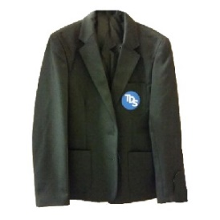



Uniform
The Duston School uniform is one of the outward signs by which the local community recognises and makes judgments about our pupils. It is important for pupils and the school that the way pupils present themselves is positive and acceptable and shows our disciplined and well ordered establishment. It is expected that all pupils will come to The Duston School every day in neat, clean uniform, giving a message that our pupils take pride in belonging to the school. The support of parents in ensuring this is expected. Pupils should recognise that conflict over the dress code is inappropriate.
The items listed form the regulation Duston School uniform and must be worn on a daily basis. Items marked with an asterisk must be purchased from the school uniform stockist.
Uniform Expectations
• The Duston School black blazer with school badge plus year colour flash*
• The Duston School V necked sleeveless jumper with school badge*
• Years 7 to 10 to wear a sky-blue shirt, Year 11 to wear a white shirt.
• Black pleated school skirt of free-flowing nature that is knee length (from uniform shop*) or black trousers. Leggings are not permitted other than for PE.
• Plain black socks that cover the ankle and reach the hem of the trouser or tights.
• Flat, black leather/leatherette shoes that can be polished – this includes patent shoes and black leather trainer shoes (eg Nike Air Force Ones). Trainers, suede /fabric footwear are not allowed Trainers are only permissible for PE lessons.
• The allocated house badge (provided by the school).
• The TDS book bag or rucksack must be in school on the pupil every day for Knowledge Organisers and pencil cases.
• Pupils are only permitted to wear one item of jewellery, eg one set of earing, one ring and one bracelet.
• Acrylic nails should not be worn to school.

Slide 14
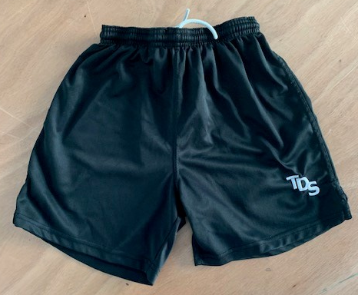
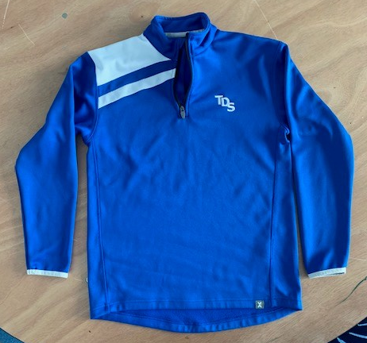
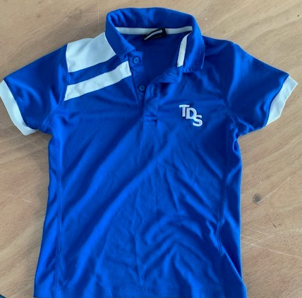
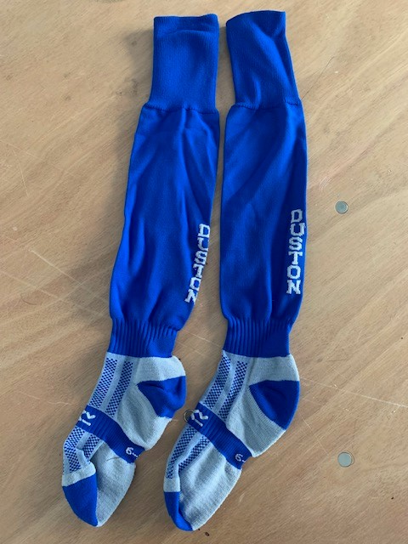
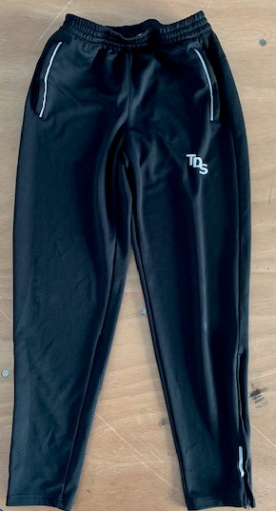
P.E. Uniform
• Facial piercings are not permitted. Where there has been a piercing, pupils should wear a clear, flat retainer. Piercings should not be carried out in term time as they take 6 weeks to heal. This should be done at the very start of the summer holidays.
• Extreme hair colours are not permissible. Pupils should have hair that is a natural hair colour.
• Make up should be natural in appearance and false eyelashes should not be worn.
• Coats, hats and scarves should not be worn inside the school building.
• Hair coverings are not permitted other than for religious purposes. The school will take note of religious exceptions and make adaptations as necessary
• TDS logoed royal blue polo shirt.*
• TDS logoed royal blue sweatshirt* or plain black unhooded sweatshirt with no tassels.
• Plain black loose-fitting shorts, cycling or Lycra style shorts are not permitted.
• Plain black tracksuit bottoms or leggings appropriate for sports.
• Plain royal blue football socks for use in winter games i.e. football.
• Plain white sport socks for use in the summer and indoor activities.
• Shin pads for use in football and hockey.
• Trainers suitable for indoor and outdoor use, casual and fashion trainers should be avoided.
• Pupils will be advised during their PE lessons of any specific equipment requirements relevant to their programme of study, for example swimming kit, football boots or mouth guards.

Slide 15
Behaviour Points
Promoting Positive Behaviour
At The Duston School, our goal is not to sanction pupils - we want to make that clear. Our focus is on creating a strong culture of achievement where positive behaviour and effort are consistently recognised and rewarded through our house points system.
We believe that pupils are capable of managing their own behaviour and making the right choices. By following simple expectations, such as being respectful, completing homework, staying focused in lessons, wearing the correct uniform, and arriving on time, pupils can avoid sanctions entirely.
Our behaviour system is designed to be straightforward and fair. Detentions are only issued when necessary, and when they are, the pupil is always given a clean slate the following day. We believe in second chances and the importance of moving forward positively.
If a pupil misbehaves a behaviour point (BP) is issued on Class Charts by the member of staff:
• If a pupil receives a behaviour point that is their warning for the day
• If a pupil receives 2 behaviour points or more in a day then they serve a 20-minute detention
• If a pupil receives 3 behaviour points or more in a day then they serve a 40-minute detention
• If a pupil receives 4 behaviour points or more in a day then they serve a 60-minute detention
• If a pupil receives 4 or more behaviour points in a week they should go on report
• If a pupil is in detention twice in a week they will also serve a 90-minute SLT detention

Slide 16

Behaviour Points
Behaviour points link to our classroom code of conduct and can also be issued for poor behavioural choices in the corridors, toilets and at break or lunchtime.
The classroom code of conduct looks as follows:

Slide 17
Inclusion
Supporting Individual Needs
Our core values of resilience, respect, and aspiration are promoted for all pupils. Our vision is to provide inclusive education wherever possible within the standard school provision. This includes a consistent teaching framework that incorporates challenge, support, and high-quality lesson delivery.
Additional support is offered under the guidance of class teachers, subject faculties, form tutors, and in partnership with you at home. Our Pupil Care provision, including the Positive Impact Centre (PIC), offers targeted support in a number of areas such as:
Self-esteem development
Protective behaviours
Anger management
Alternative provision
Literacy support
Dyslexia, dyspraxia, and speech and language interventions
In addition, our counselling, attendance, and safeguarding teams work collaboratively within the Pupil Care model to ensure comprehensive support for pupils’ wellbeing and development.
Special Educational Needs and Disabilities (SEND)
We are committed to valuing each pupil as an individual. We foster an inclusive ethos that combines high expectations with appropriate support to enable every learner to thrive. Our broad and balanced curriculum is adapted to meet individual needs, and we have robust systems in place for the early identification of any barriers to learning or participation.
We believe that educational inclusion is about ensuring equal opportunities for all learners regardless of age, gender, ethnicity, background, or individual learning needs.
SEND Provision
We currently provide additional or alternative support for a wide range of needs, including but not limited to:
Communication and Interaction
e.g. Autism Spectrum Disorder, Asperger’s Syndrome, speech and language difficulties
Cognition and Learning
e.g. Dyslexia, dyspraxia
Social, Emotional and Mental Health (SEMH)
e.g. Attention Deficit Hyperactivity Disorder (ADHD), anxiety, emotional regulation issues
Sensory and/or Physical Needs
e.g. Visual and hearing impairments, sensory processing difficulties, epilepsy
Moderate, Severe, and Profound Learning Difficulties
Including complex or multiple learning needs

Slide 18
Inclusion – SEND
Identifying When Your Child Needs Additional Support
When your child joins us, we gather information from a variety of sources to help us understand their needs:
Reports from primary school teachers, Key Stage 2 results and pupil data files.
Baseline assessments and other initial tests conducted during Year 7 and the transition period.
Information provided by parents/carers through the application form and data records.
Observations and comments from subject teachers during the first term.
Reports from specialist staff and external agencies.
As your child progresses through school, we continue to monitor their development and gather information through:
Termly assessments and interim progress data.
Feedback from subject teachers and tutors.
Concerns raised by parents/carers.
Referrals and reports from external agencies.
Our Teaching Approach for Pupils with SEND
We have high expectations for all our pupils, including those with Special Educational Needs and Disabilities (SEND). Teachers are informed of each pupil’s individual needs and make reasonable adjustments to ensure that lessons are accessible and inclusive. All staff are experienced and trained in adapting their teaching strategies to meet a wide range of learning requirements. This may involve using differentiated strategies, practical activities, or tailored resources to support full participation in lessons.
While most pupils follow a traditional curriculum, a small number receive a more personalised programme that reflects their specific needs, interests, and abilities. This can include tailored option choices, additional literacy support, nurture groups, intervention programmes, and a modified number of qualifications.
Resources are allocated based on assessed need and proven effectiveness. For pupils with an Education, Health and Care Plan (EHCP), support and resources are provided in accordance with the provisions outlined in their plan. Where available, Teaching Assistants are deployed to support pupils in lessons.
Our staff work closely with pupils, colleagues, and families to maximise support. They bring a wide range of expertise to help pupils both directly and indirectly, assist teaching staff, and provide guidance to parents and guardians.

Slide 19
Inclusion – Positive Impact Centre
Ethos:
Mirrors that of the school as a whole; the environment is underpinned by the core values;
RESPECT - RESILIENCE - ASPIRATION.
Enabling students to gain the knowledge of themselves to access the knowledge of the wider curriculum.
Supporting students across our 7 strands of impact to become successful in any classroom or wider social environment by providing a personalised learning experience.
Offering a firm, consistent, safe learning environment in which pupils can work on and develop their full social, emotional and academic potential. Students will have the opportunity to address challenges and barriers relating to their current behaviour / attitude and adopt practical strategies, coping mechanisms and explore different approaches to grow and develop as a confident learner.
Aims:
Build positive relationships
Improve attendance/attainment.
Improve overall emotional wellbeing/mental health.
To encourage students to make better decisions as learners and encourage positive behaviour.
Improve behaviour and self-regulation.
To enable academic progress.
To develop social and emotional skills.
To establish strategies and coping mechanisms for students to explore and utilise.
To work collaboratively with families and agencies.
Prepare for re-integration or transition.
Prevent PEX.
7 Strands of Impact:
Strand 1: Alternative Provision for KS3 pupils (up to 12-week full-time programme)
Strand 2: Wellbeing Interventions (Short term focus groups/1-1 sessions)
Peer Mentoring
Strand 3: RESET
Personalised support following suspension/period of absence
Strand 4: Counselling Service (Targeted support)
Strand 5: Further Support Mental Health
- CAMHs/MHST
- Lowdown/Service Six
Strand 6: Parenting Course (Solihull Approach)
Strand 7: EAL

Slide 20
Attendance
It is essential that pupils arrive at school with plenty of time to organise themselves for the start of their day.
Arrival times to school are:
8:25am – Year 7 and Year 8
8.30am - Post 16, Year 9, Year 10 and Year 11
Please be advised that these times may be subject to change
TDS attendance expectations
Pupils are legally required to attend school every day and should only be absent for illnesses. If a pupil is not in school, they must have a justified reason given by an adult (one with parental responsibility) that represents them. We ask parents to arrange medical appointments out of school hours, where possible.
If a pupil is absent from school, please report their absence via the Class Charts App. Please see the school website for further information - The Duston School - Attendance
Absence should continue to be reported on a daily basis unless a medical note is supplied stating the period of absence which can then be approved by the school.
Lates to school
Arrival once Year Group line up has finished to 9:00 am: 20-minute same-day detention
Arrival between 9:00 am and 9:30 am: 40-minute same-day detention
Arrival between 9:30 am and 10:00 am: 60-minute same-day detention
Arrival after 10:00 am: 60 minute same-day detention plus a 90-minute Senior Leadership detention (Thursdays)
To school during any given week-
The regularity of lateness to school during the course of the week / term will be reviewed daily. Repeatedly arriving to school late will result in an isolation including an SLT detention for 90 minutes.
Ongoing repeated lateness will result in a suspension
Absence for Term Time Holidays
Any application for leave must only be in exceptional circumstances (agreed at the discretion of the Principal) and parents will be fined by the Local Authority for taking their child on holiday without the consent of the school. Any requests for term time holidays need to be sent to office@thedustonschool.org

Slide 21
School Day
Monday
Time | Lesson
08:25am | Line-ups
08:45am - 09:30am | Character Session
09:30 am - 10:30am | Period 1
10:30am - 11:30am | Period 2
11:30am - 11.50am | Break
11.50am - 12:50pm | Period 3
12.50pm - 2:20pm | Period 4 & Lunch
2:20pm - 3.25pm | Period 5
Tuesday to Friday
Time | Lesson
08:25am | Line-ups
08:45am - 09:00am | Tutor Time
09:00 am - 10.00am | Period 1
10:00am - 11:00am | Period 2
11:00am - 11.20am | Break
11.20am - 12:20pm | Period 3
12.20pm - 1.50pm | Period 4 & Lunch
1:50pm - 2:55pm | Period 5

Slide 22
Lunchtime
Cashless Catering / ParentPay
It’s simple, safe and convenient and your child no longer needs to carry cash into school. ParentPay is an online payment system for schools. It allows parents to pay quickly and securely for school meals, trips and activities, lockers, music lessons and fees. You simply top-up your ParentPay account online by debit or credit card, or in cash through PayPoint stores. Your ParentPay balance can be used immediately to pay for any of your children’s items at school using ParentPay.
What are the benefits to parents and pupils?
ParentPay is easy-to-use and will offer you the freedom to make online payments whenever and wherever you like, 24hrs a day 7 days a week.
The technology used is of the highest internet security available ensuring that your money will reach school safely – offering you peace of mind.
Payments can be made by credit or debit card.
Full payment histories and statements are available to you securely online at any time.
Your children won’t have to worry about losing money at school again.
What are the benefits to our school?
When parents use ParentPay, the benefit to the school is huge. You will help us to reduce workloads for all staff, creating more time to lend to educational support and the smooth running of the school. Using ParentPay also ensures that all financial transactions are safe and secure - helping us to remove costs associated with us having to manage cash securely on the school premises.
Are you applicable for Free School Meals?
If you are in receipt of any of the following, your child may be eligible for free school meals.
Income Support
Income based Job Seekers Allowance
Income related Employment and Support Allowance
Support under Part VI of the Immigration and Asylum Act 1999
Child Tax Credit, with no element of Working Tax Credit, and a household income below £16,190 (as assessed by HM Revenue and Customs)
Guarantee Element of State Pension Credit
Universal Credit
If a child resides in a local authority care home they will not qualify for free school meals. This is because government funding has already been allocated to fund their meals. A child must reside with the applicant to receive free school meals.

Slide 23
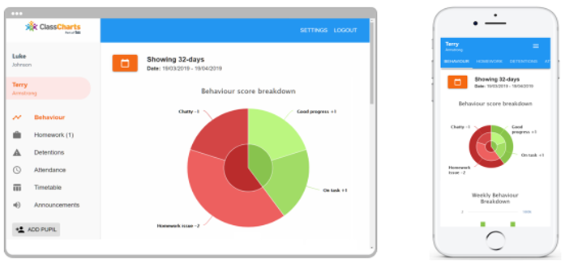
Communication
Parents/ carers play a crucial role in ensuring their child achieves at the highest level, meets their targets and makes the most of their opportunities at the school. We provide regular data for parents to ensure they have the latest information on their child’s progress. Included with these are the email addresses of all of your child’s teachers who you may contact.
Tutors act as the main point of contact with parents and are expected to have regular communication for each of their tutees. We expect 100% attendance at virtual parents’ events, this ensures that parents can receive direct feedback on how well their child is performing across their range of subjects.
The school uses an online platform called
ClassCharts to communicate with parents.
This will show you their rewards, behaviour,
timetable, homework, attendance,
detentions and all messages home.
Whole-school letters are sent via ClassCharts. Please ensure that you create an account as soon as your child starts at the school.
On the school website you will find up to date information regarding the school, including policies, and term dates as well as a link to ParentPay.
Medicines and Medical Conditions
If your child takes any medicines or has any medical conditions please inform the school so that records can be kept for either the routine taking of medicine or in case of an emergency.
The school has a number of first aid trained staff who are routinely trained to assist pupils with illness and injuries. Pupils can take medicine in school under supervision by informing the school in advance. We will not administer paracetamol/ibuprofen without prior consent of parents.
Vaccinations will take place routinely in school and parents will receive notification and consent forms in advance. The school will also facilitate appointments with the school nurse.

Slide 24
Lost Property
When pupils come to the school we do request that all their possessions, including clothing, should be named, in order to facilitate returning found articles. All lost property should be handed in at reception. If a pupil loses any item he / she should ask at the reception if it has been found.
Named items are returned to pupils via Tutors; it will clearly help us to return items to their owners much more readily if everything is named. Please, therefore, ensure that all of your child’s clothing and personal belongings are named. Items that are not named are placed in Lost Property. These are held until the end of term and then put on display for the pupils to look at. Any unclaimed property will then be disposed of.
Media, Film and Photographs
From time to time the school receives requests from the media to take photographs and/or films of school events and activities. The school also takes photographs and makes films for our own purposes. We seek parental consent to do so on a separate form in your admissions packs. If at any time you wish to withdraw this consent you may do so by contacting: standards@thedustonschool.org
Mobile Phones & Smart Watches
Pupils are forbidden from using their mobile phones, smart watches and other electrical devices at any point on the school site. Any pupil found using a mobile phone or smart watch during the day will have the device confiscated. It will not be returned until the following Monday (unless it is a bank holiday, when it will be returned on a Tuesday). During the final week of a term any confiscated phones are returned on the last day of term.
If pupils need to make contact with home, they are allowed to use the phone in reception.
The school accepts no responsibility for the safety or security of the above equipment.
Further information regarding electronic devices can be found in the school's behaviour policy on the school website.

Slide 25
Causes for Concern
Any parent who has any concerns about any aspect of the school, be it curriculum based, pastoral or administrative, is encouraged to contact the school at the earliest possible opportunity to register their concern by speaking to their child’s tutor.
Where there is a cause for concern, details will be forwarded to the appropriate member of staff for their attention and investigation.
Parents will be kept fully informed of the situation and the final outcome.
Please Note
In the case of any serious safeguarding matters, should any parent wish to come into the school to directly discuss any concerns they may have, the school will endeavour to have a senior member of staff available. This should be through an arranged appointment .
Should this not be possible, full details will be taken and forwarded to the appropriate senior member of staff without delay.
Leaving the School
If, for any reason, you have to withdraw your child from the school, we require the information in writing to the Principal.
We also need to know which school your child is transferring to as this enables the leaving procedures to be put in place and necessary documents drawn up.

Slide 26
Key Staff Contacts
Senior Leadership Team
Mr S Strickland | Principal | office@thedustonschool.org
Mrs N Adams | Senior Vice Principal - Director of Education | nadams@thedustonschool.org
Mrs K Loomes | Vice Principal - Head of Primary | kloomes@thedustonschool.org
Mrs M Jones | Vice Principal - Head of KS3 | mjones@thedustonschool.org
Mr T Wise | Senior Vice Principal - Head of KS4 | twise@thedustonschool.org
Mrs N Montagu | Vice Principal - Head of KS5 | nmontagu@thedustonschool.org
Mr P Dewes | Vice Principal-Safeguarding and Attendance | pdewes@thedustonschool.org
Miss S Pragnell | Assistant Principal – Primary | spragnell@thedustonschool.org
Mr C Nelson | Assistant Principal - Deputy Head of KS3 | cnelson@thedustonschool.org
Miss J Giles | Assistant Principal –Strategic Lead Transition and Year 7 | jgiles@thedustonschool.org
Mrs G Perry | Assistant Principal –Senior Mental Health and Wellbeing | gperry@thedustonschool.org
Mr S Beal | Senior Assistant Principal | sbeal@thedustonschool.org
Mr S Wade | Assistant Principal - Deputy Head of KS4 | swade@thedustonschool.org
Mr A Clarke | Assistant Principal -Data , Exams and Standards | aclarke@thedustonschool.org
Ms K Shires | Assistant Principal -School Improvement | kshires@thedustonschool.org
Ms R King | Assistant Principal: Teaching and Learning | rking@thedustonschool.org
Mrs S Connor | School Business Manager and Chief Finance Officer | sconnor@thedustonschool.org
Subject Heads
Mr A Smith | Head of Art and Design | asmith@thedustonschool.org
Miss Emily Butcher | Head of CBI | ebutcher@thedustonschool.org
Miss G Berrill | Head of English | gberrill@thedustonschool.org
Mrs S Malia | Head of Geography | smalia@thedustonschool.org
Mr M Evans | Head of Maths | mevans@thedustonschool.org
Miss R Oliver | Head of MFL | rtemplefry@thedustonschool.org
Miss F Hope | Head of Music and Performing Arts | fhope@thedustonschool.org
Mr S Croft | Head of Science | scroft@thedustonschool.org
Mr P Wood | Head of Sport | pwood@thedustonschool.org
Miss M Hodges | Head of History and Politics | mhodges@thedustonschool.org
Subject Leads
Mr J Allen | Lead Teacher of Citizenship & RE | jallen@thedustonschool.org
Ms L Jalporte | Lead Teacher Art | ljalporte@thedustonschool.org
Miss R Oliver | Head Of MFL | rtemplefry@thedustonschool.org
Mr C Dunkley | Second in Maths | cdunkley@thedustonschool.org
Mr J Robinson | Lead Teacher of PE | jrobinson@thedustonschool.org
Mr H Boycott | Head of Physics | hboycott@thedustonschool.org
Miss K McColl | i/c PSHE | kmccoll@thedustonschool.org
Mr A Mosdell | Lead Teacher of Social Sciences | amosdell@thedustonschool.org
Mrs R Boycott | Second in Science | rboycott@thedustonschool.org
Mr S Mannion | Lead Practitioner; Maths | smannion@thedustonschool.org
Miss I Weaver | Lead Practitioner Science | iweaver@thedustonschool.org
Mr S Ackbarally | Lead Practitioner of IIT, IQM and IIP | sackbarally@thedustonschool.org
Directors of Years
Mrs McDonald | Director of Year 7 | hmcdonald@thedustonschool.org
Mrs K Wells | Director of Year 8 | kmccoll@thedustonschool.org
Mr S Elliot | Director of Year 9 | selliott@thedustonschool.org
Mr J Marshall | Director of Year 10 | jmarshall@thedustonschool.org
Mr A Brown | Director of Year 11 | abrown@thedustonschool.org
Mr N Floyer | Head of Year 12 & i/c of KS4 Media | nfloyer@thedustonschool.org
Mrs G Martin | Head of Year 13 | gmartin@thedustonschool.org
Assistant Directors of Years
Miss Z Ward | Assistant Director of Year 7 | zward@thedustonschool.org
Mrs S Quinn | Assistant Director of Year 8 | Squinn@thedustonschool.org
Miss H Monaghan | Assistant Director of Year 9 | hmonaghan@thedustonschool.org
Mr I Honer | Assistant Director of Year 10 | Ihoner@thedustonschool.org
Miss D Kimpton | Assistant Director of Year 11 | Dkimpton@thedustonschool.org
Mrs T Ward | Assistant Director of Sixth Form | tward@thedustonschool.org

Slide 27
Term Dates 2026/7
2026 Term 1 Tuesday 1st September and Wednesday 2nd September – INSET Days Commences for pupils Thursday 3rd September – Friday 23rd October Thursday 3rd September – Years 1-6, 7 and 12 only in school Friday 4th September – Years 1-6, 7 and 13 only in school All pupils return on Monday 7th September October Half Term Holiday: Saturday 24th October – Sunday 8th November
2026 Term 2 Monday 9th November – Thursday 17th December Friday 18th December – Staff Training Day Christmas Holiday for pupils: Friday 18th December – Sunday 3rd January
2027 Term 3 Tuesday 5th January – Friday 12th February Monday 4th January – Staff Training Day Tuesday 5th January – All pupils return to school February Half Term Holiday: Saturday 13th February – Sunday 21st February
2027 Term 4 Monday 22nd February – Thursday 25th March Friday 26th March – Bank Holiday Easter Holiday – Friday 26th March – Sunday 11th April
2027 Term 5 Monday 12th April – Friday 28th May May Bank Holiday – Monday 3rd May May Half Term – Saturday 29th May – Sunday 6th June
2027 Term 6 Monday 7th June – Wednesday 21st July (for pupils) Thursday 22nd – Staff Training Day Summer Holiday commences Thursday 22nd July for pupils
Please do note that term dates are subject to change pending receipt of changes to the Local Authority’s proposed term dates.

Slide 28
www.thedustonschool.org
The Duston School Berrywood Road
Duston
Northampton
NN5 6XA
T: 01604 460004 E: office@thedustonschool.org

