Slide 1
Year 6 Grammar

Slide 2
Recap: Capital Letters
Capital Letters need to be used for:
At the start of every new sentence.
Example: The group started to walk peacefully down the track.
Name of people and places (Proper Nouns)
Example: Miss. Smith asked the class to listen.
Personal Pronoun ‘I’
Example: I often thought I could try harder in school.
In abbreviations
Example: The BBC was showing my favourite film.
Days of the Week
Example: On Monday we always have an assembly.
Months of the Year
Example: My favourite time of the year is December.
Film and Book Titles
Example: My favourite book is Crater Lake.

Slide 3
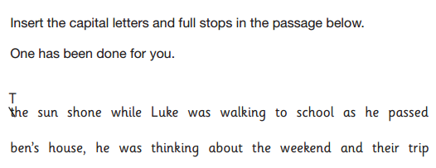
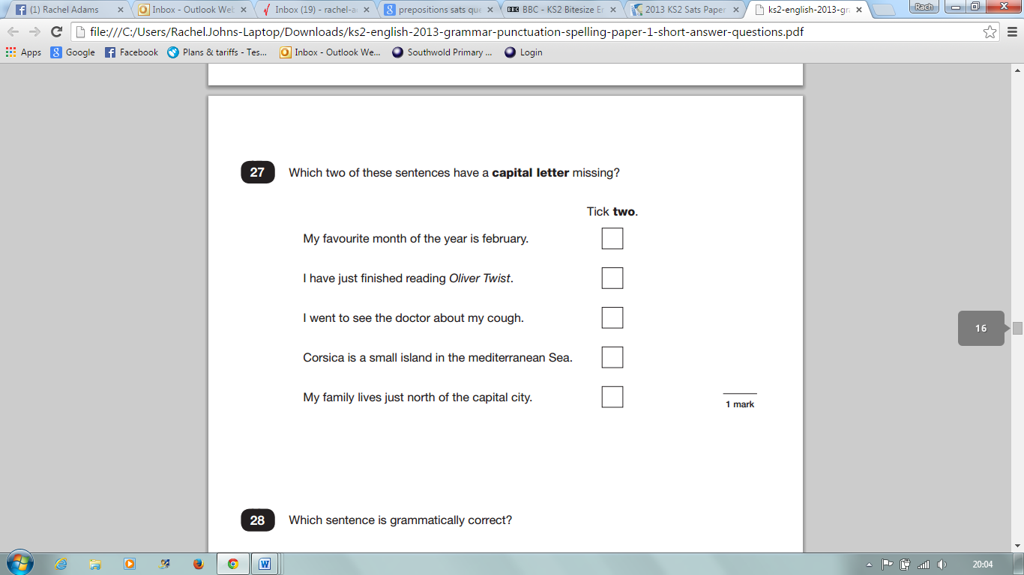
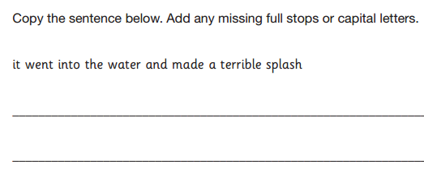
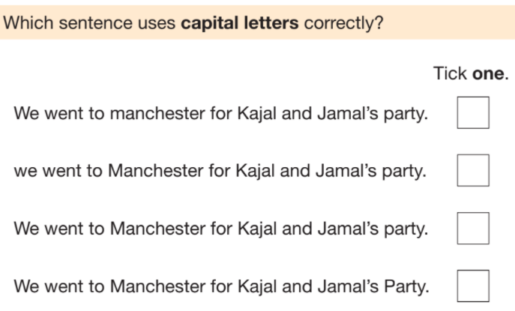
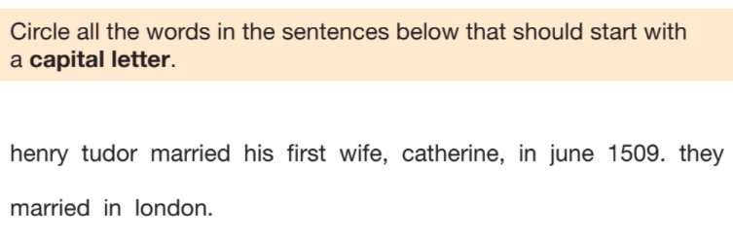
Recap: Capital Letters

Slide 4
Recap: Question Marks
The main purpose of a question mark, is to indicate that the sentence is a question. Most questions often, but not always, begin with who, what, when, where and why.
Examples:
Who is making that noise?
What is that coming over the hill?
Why do we have to learn about algebra?
Does anyone have a pen I could borrow?
In what country does coffee originate?

Slide 5
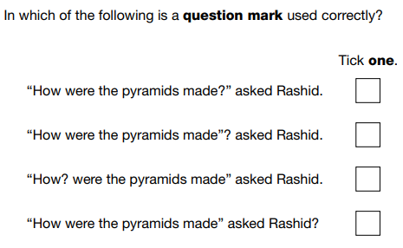
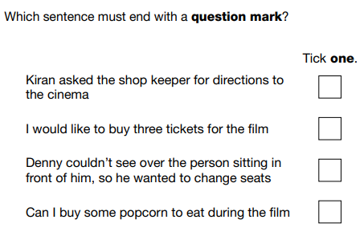
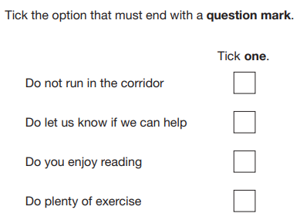
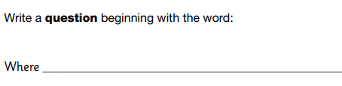
Recap: Question Marks

Slide 6
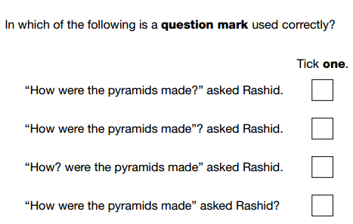
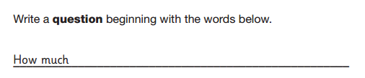
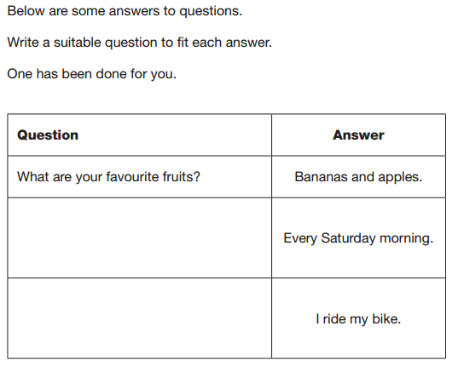
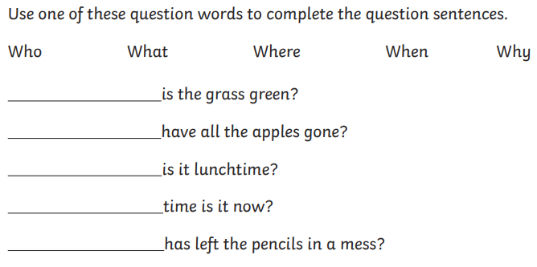
Questions

Slide 7
Recap: Exclamation Marks
The exclamation mark is used at the end of a sentence or short phrase which expressed a strong feeling.
Exclamations are often seen after an exclamation beginning what or how, but not always.
Exclamation marks are usually not used in formal writing.
Examples:
What a lovely view you have here!
That’s fantastic!
How well Marshall bowled yesterday!
Exclamations
An exclamation is a forceful statement which expresses high levels of emotion or excitement. Exclamations always begin with ‘what’ or ‘how’ and need to be punctuated with an exclamation mark ( ! ).

Slide 8
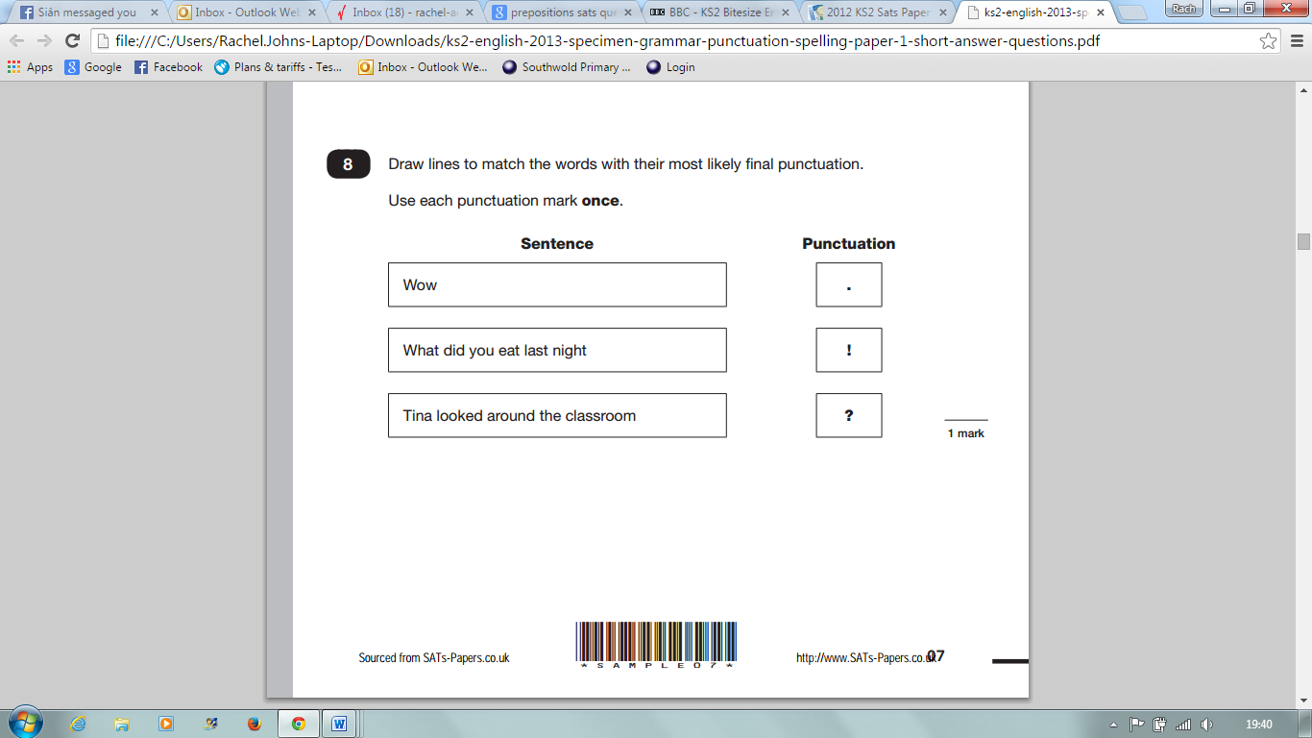
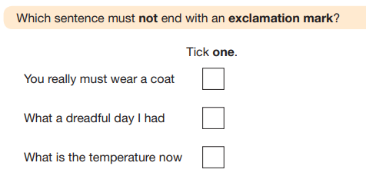
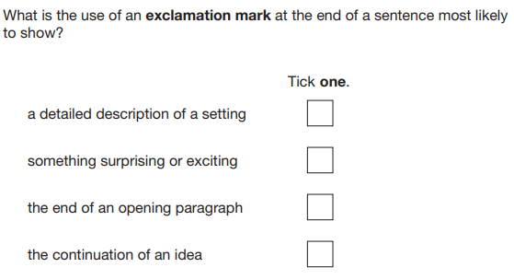
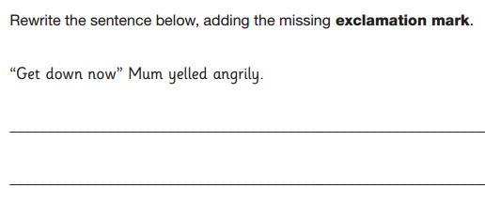
Recap: Exclamation Marks

Slide 9
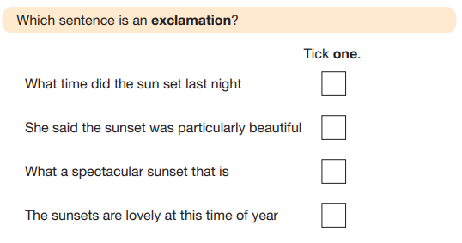
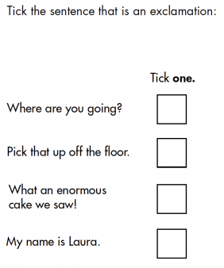
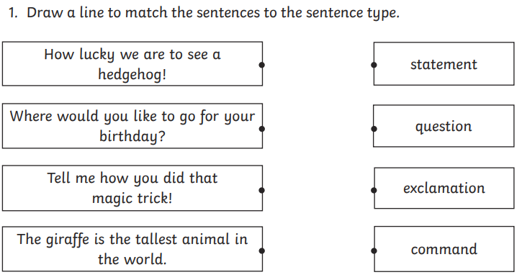
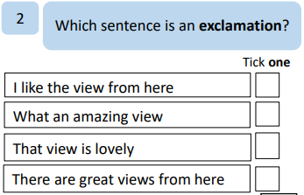
Exclamations

Slide 10
Prefixes
Prefixes are short syllables which are added to the start of a word to give it a new meaning.
Examples:
Pre + View = Preview
Dis + Agree = Disagree.
Common Prefixes include:
Anti = anti-war
De = destroy
Dis = disagree
En/Em = encode, embrace
Fore = forecast
In/Im = intake, implant
Inter = interact
Suffixes
Suffixes are short syllables added to the end of a word to give it a new meaning.
Examples:
Turn + ed = Turned
Quick + ly = Quickly
Common Suffixes include:
-able = doable
-ible = reversible
-al = personal
-ed = turned, jumped
-en = golden
-er = actor, higher
-est = biggest, largest

Slide 11
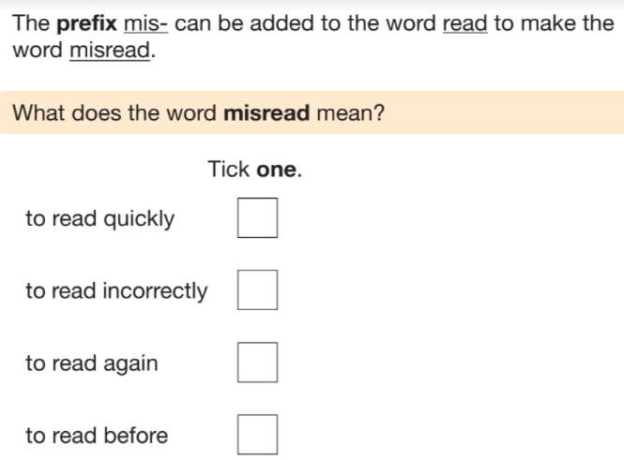
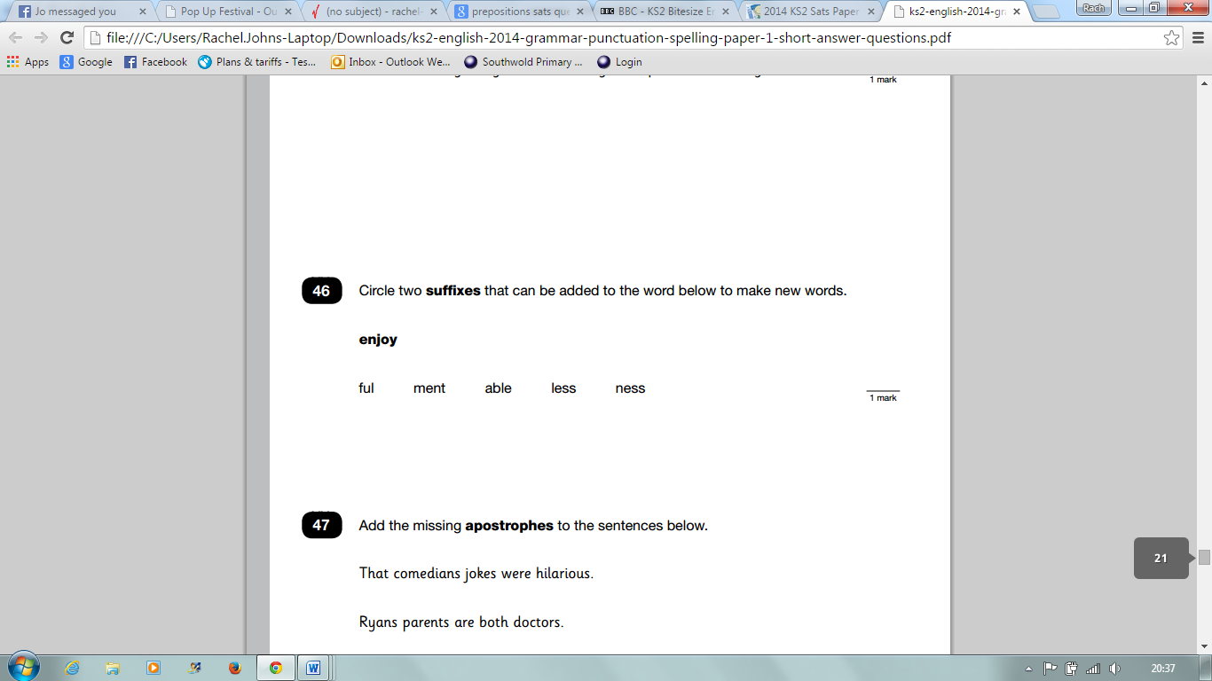
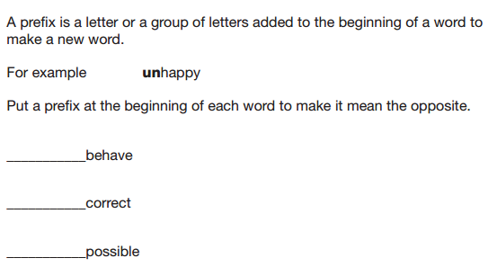
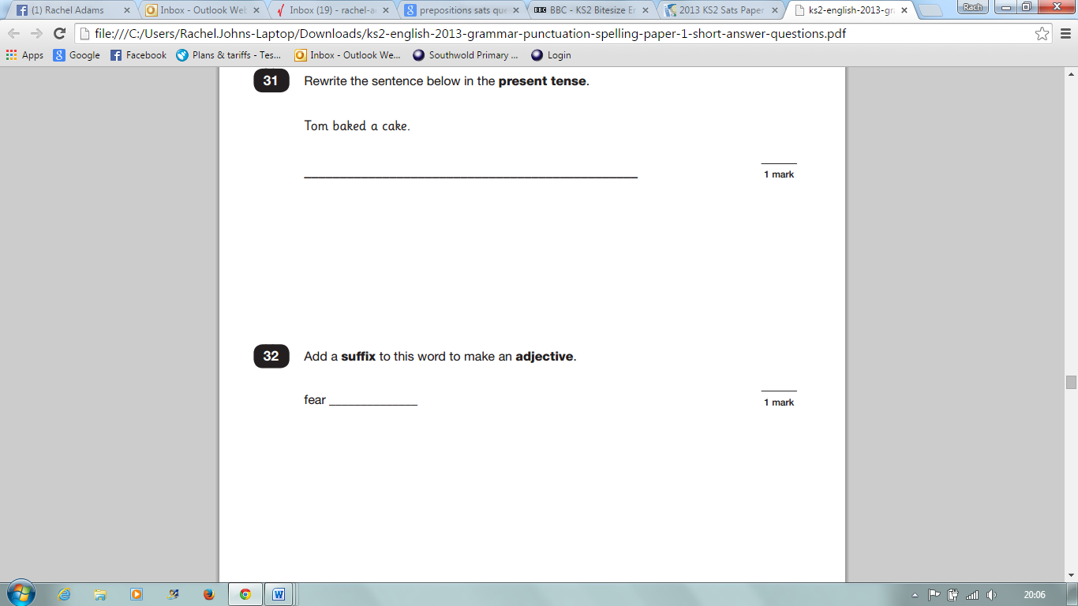
Prefixes and Suffixes

Slide 12
Nouns
Nouns name things, people and places.
Most nouns can either be singular (only one) or plural (lots of them).
A collective noun is a noun that refers to a group (Examples: herd, flock, and team).
Proper nouns begin with capital letters and name people, places and organisations (Examples: Michael, London, Mrs Sullivan).
Days of the week and months of the year should also begin with a capital letter (Examples: Tuesday, September).
Concrete nouns are nouns that name people, places and things that can be experienced through the five senses (Examples: garage, rain, bird).
Abstract nouns name feelings, ideas and concepts and cannot be touched (Examples: hate, anger, jealousy).
All other nouns are called common nouns. Common nouns is a type of noun used to refer to general objects, places, people and animals.

Slide 13
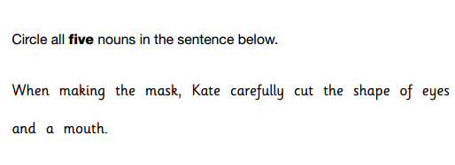
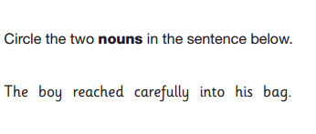
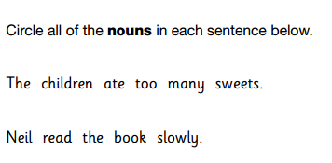
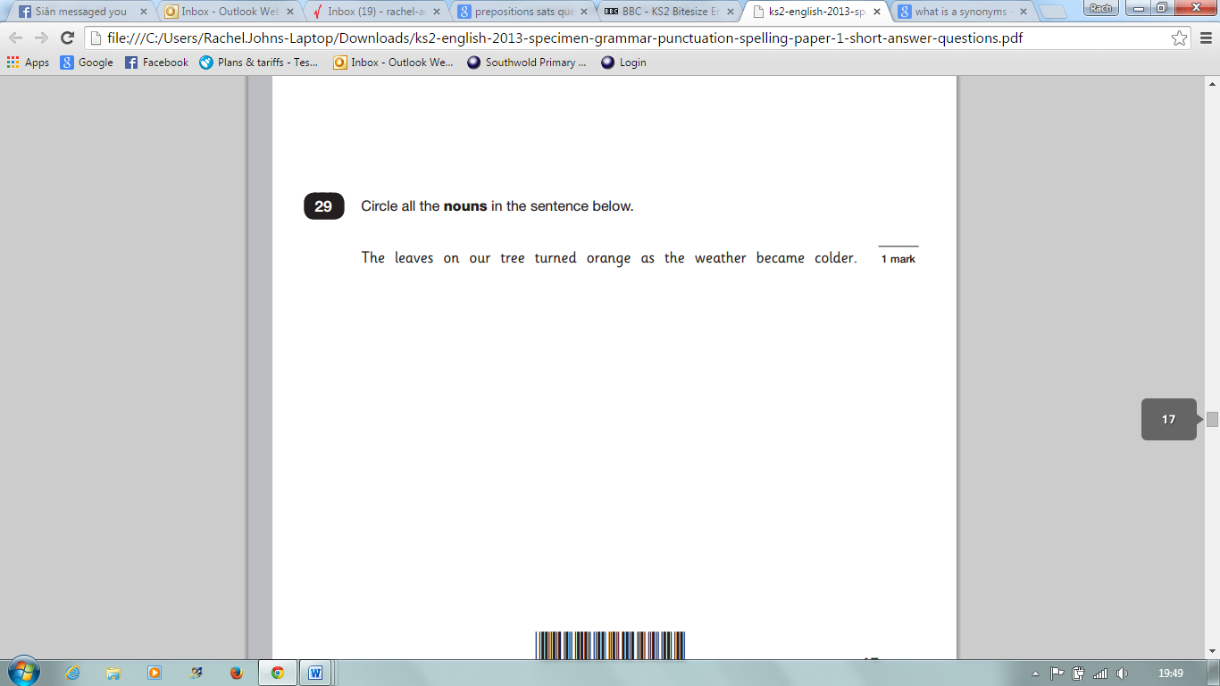
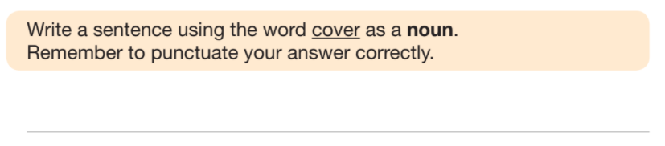
Nouns

Slide 14
Pronouns
Pronouns are words that stand in place of a noun.
They are helpful because they help writers not having to repeat themselves.
(Example: The dog looked at the sandwich and then it ate it).
Personal pronouns are short words which we use instead of a person’s name.
(Examples: I, you, he, she, it, we, they, me, him, her, us, them)
Relative pronouns relate back to someone or something already mentioned.
(Examples: who, which, that, whom, whose).
Possessive pronouns are pronouns that shown ownership.
(Examples: mine, ours, yours, his, hers, its, theirs).

Slide 15
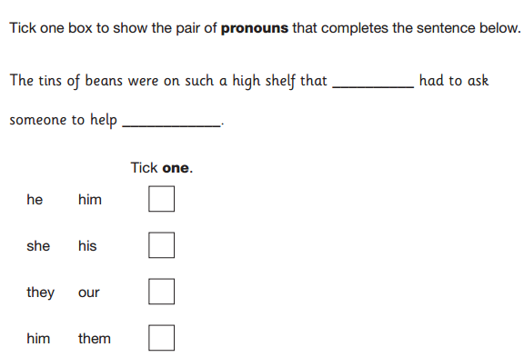
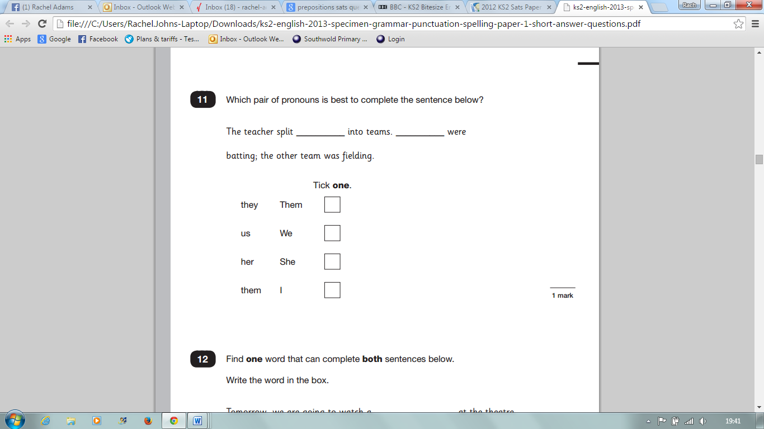
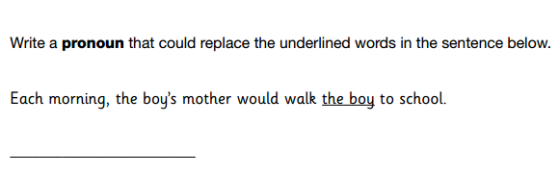
Pronouns

Slide 16
Noun Phrases
A noun phrase is a group of words that functions as a noun in a sentence. They help to identify the noun.
When adjectives are added to a noun phrase, we call it an expanded noun phrase.
Examples:
The cat played a fiddle
‘The cat’ is a simple noun phrase.
The intelligent, ginger cat played the fiddle.
Adding adjectives ‘intelligent and ginger’ means it has become an expanded noun phrase.
Remember to add commas in between your adjectives.

Slide 17
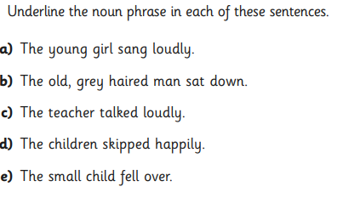
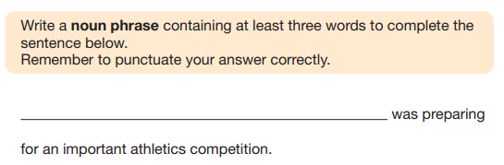
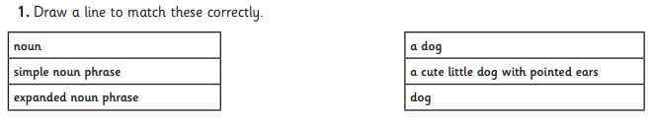
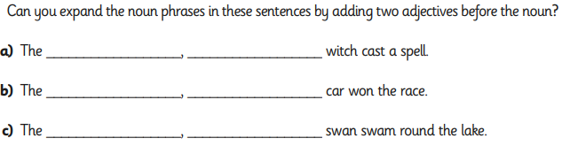
Noun Phrases

Slide 18
Adjectives
An adjective is a word that describes a noun or a pronoun and add more detail for the reader.
They can be found in different parts of the sentence.
To create an adjective you usually need to add a suffix like ‘ful’ or ‘less’.
(Examples: wonderful, beautiful, painless and merciless)

Slide 19
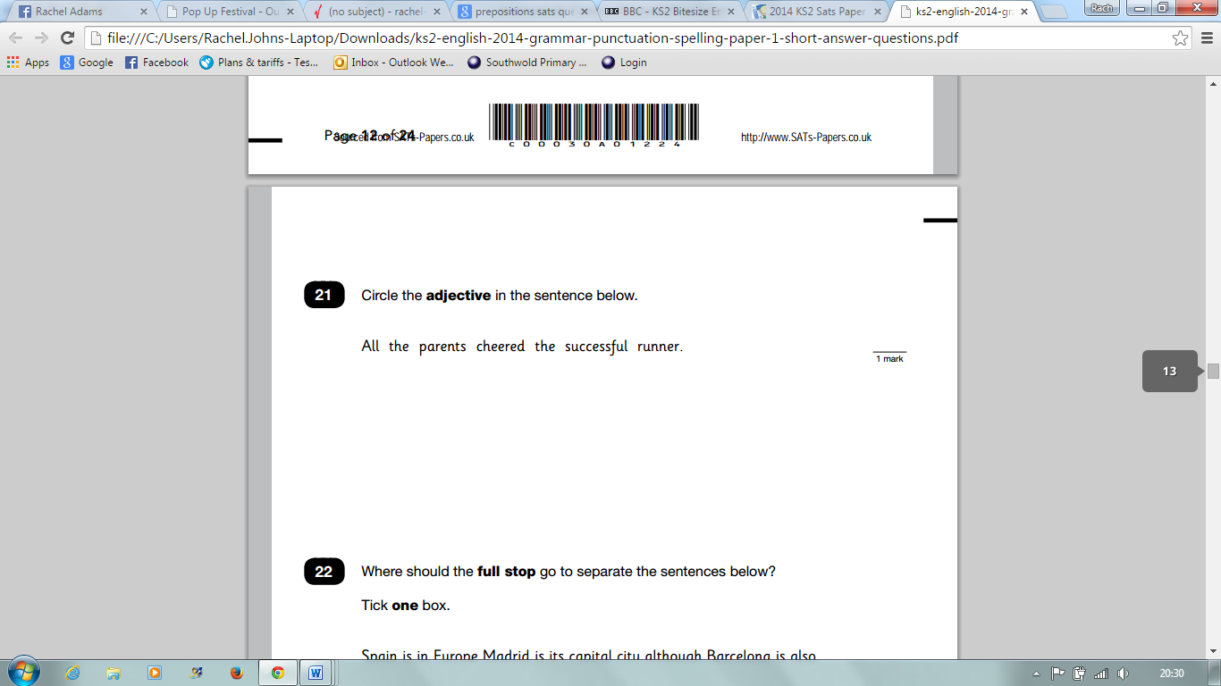
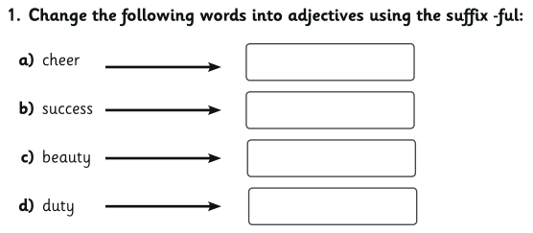
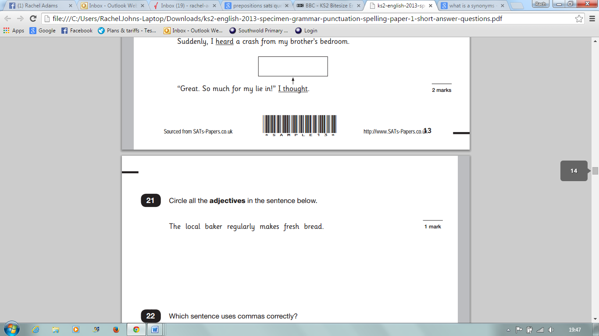
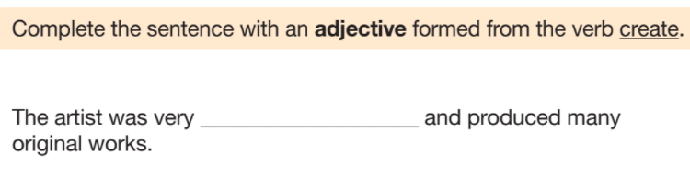
Adjectives

Slide 20
Verbs
A verb is an action word (‘doing word’) – they show you what a person or thing is doing or being.
(Examples: run, dance, slide)
Whoever’s doing the verb in a sentence is the subject. The object has the verb done to it.
(Example: The cat sits on the sofa).
The cat = subject
The sofa = object
Modal Verbs show possibility – how likely things are to happen.
(Examples: may, might, shall)
(Example - I will play badminton on Tuesday, but I might clean my room first).

Slide 21
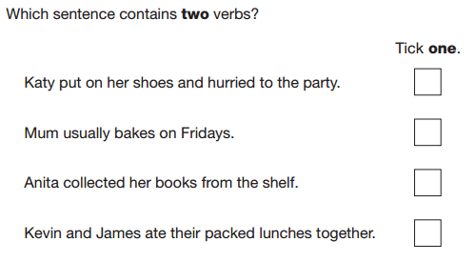
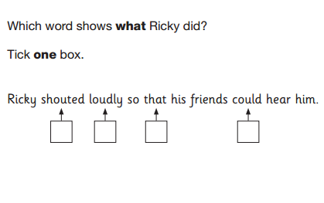
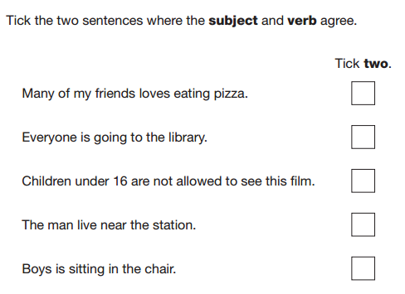
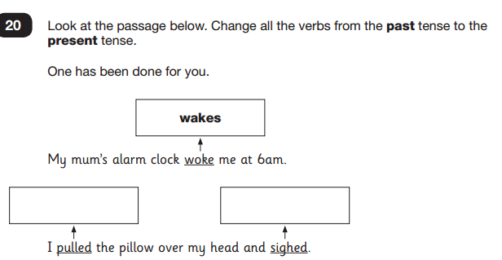
Verbs

Slide 22
Adverbs
Adverbs are describing words that give added meaning to verbs.
Adverbs often end in ly, but not always.
Examples in a sentence: The extremely cute cat slept.
The cat purred rather noisily.
Usually, the cat is sleeping.
The frog neverjumps over two lily pads.

Slide 23
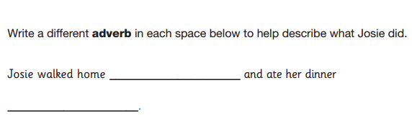
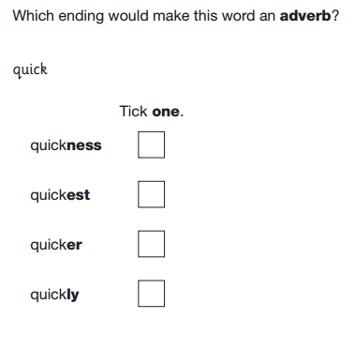
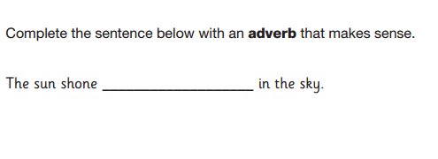
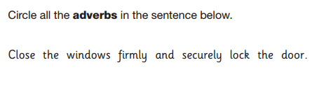
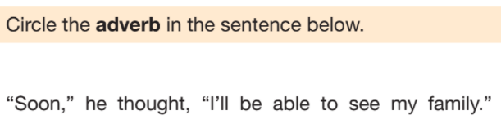
Adverbs

Slide 24
Adverbials
An adverbial is a term for any word, phrase or clause that gives extra meaning to the main verb or clause within a sentence.
They can explain manner, place or time.
Examples: The cat slept peacefully. (adverb)
: The cat slept in a peaceful manner. (adverbial phrase)
Fronted adverbials, use adverbials to describe: time, frequency, place, manner, possibility.
All fronted adverbials are found at the front of a sentence and must be followed by a comma.
Examples:
(Time) Before sunrise, Darius crept into the beast’s cave.
(Frequency) Every so often, Darius could hear the beast’s ferocious snore.
(Place) At the back of the cave, the terrifying creature began to stir.
(Manner) As quick as a flash, Darius bounded behind a nearby rock.
(Possibility) Almost certainly, the deadly beast would find Darius.

Slide 25



Adverbials

Slide 26
Prepositions
Prepositions are little words that show – how they are related in time or space.
(Examples (Time): at, during, in, on).
(Examples (Space): to, over, in, on, under).
Examples in a sentence: In the morning, the cat often hides under the table.
The train leaves at three o’clock from platform four.

Slide 27




Prepositions

Slide 28
Determiners
A determiner is like a special adjective that pins down precisely which noun is being talked about.
(Example: That dog barked at this man).
There are different types of determiners:
Articles – a, an, the
Demonstratives – this, that, those, these
Possessives – my, your, his, her, its, our, their
Quantifiers – many, few, some, any, no, much, both, all, every, each, none of, a little.
Numbers – two, three, second, first
Some question words – which, what, whose.

Slide 29




Determiners

Slide 30
Connectives
A connective is a word or group of words that joins one part of a text to another, normally paragraphs.
Connectives can be conjunctions, prepositions or adverbs.
Examples:
Adding | Time | Cause/Effect | Contrasting
and moreover also as well as furthermore | next then finally meanwhile eventually | because therefore so consequently as a result of | however alternatively although except unless

Slide 31




Connectives

Slide 32
Conjunctions
A conjunction links two or more words, phrases or clauses together.
There are two main types of conjunctions. They are co-ordinating conjunctions and subordinating conjunctions.
co-ordinating conjunctions link two main clauses together as an equal pair to create a compound sentence.
F = For
A = And
N = Nor
B = But
O = Or
Y = Yet
S = So
subordinating conjunctions introduce a subordinate clause.
I = If
S= Since
A = As
W = When
A = Although
W = While
A = After
B = Before
U = Until
B = Because

Slide 33




Conjunctions

Slide 34
Synonyms
A synonym is a word that has a similar meaning to another.
Similar means almost the same but with a small difference.
Examples:
good = fine
sad = miserable
Ancient = old
Antonyms
An antonym is a word which has the opposite in meaning to another.
Examples:
Achieve = fail
Gloomy = cheerful
Ancient = modern

Slide 35




Synonyms

Slide 36




Antonyms

Slide 37

Statements
They tell the reader a fact, idea or opinion about a single topic.
Statements can be simple, compound or complex sentences; and always include a subject and verb.
They nearly always end in a full stop, but can also end in an exclamation mark.

Slide 38




Statements

Slide 39
Commands
Command sentences tell someone to do something.
Commands usually, but not always start with an imperative verb (bossy word).
Commands normally end in a full stop or an exclamation mark.
Examples of imperative verbs:
add
bend
chop
close
fill
fold
hit
mix
open
pour
put
roll
Example Commands:
Chop the onions!
Fry the ingredients in a pan.
Finally, season with salt and pepper.

Slide 40




Commands

Slide 41
Relative Clauses
Relative clauses give extra information related to a previously mentioned noun or pronoun.
A relative clause always starts with a relative pronoun.
Relative Pronoun | Relate to…
Who | Relates to people (subject)
Whom | Relates to people (object)
Which | Relates to animals and objects
Why | Refers to a reason
When | Refers to a time
Where | Refers to places
Whose | Refers to possession
That | Relates to people, animals and things
Example:
Jess, who was dressed at Batman, was going to a fancy dress party.
Who is a relative pronoun, so this clause of extra information is called a relative clause.

Slide 42




Relative Clauses

Slide 43
Simple past tense
Simple past tense tells us that the action has already happened and been completed.
We usually add the suffix –ed to the root word.
I played.
We played.
Example:
I played football with my neighbours.
You played.
They played.
Simple present tense
The simple present tense is used to show actions in the near future and actions happening now.
Example:
I play tennis.
The train leaves tonight at 6 PM.

Slide 44




Simple past tense

Slide 45


Simple present tense

Slide 46
Present Progressive Tense
The progressive tense (or continuous tense) usually describes verbs and events that are ongoing.
For present progressive tense, we usually use is, am or are, before adding the suffix ‘ing’ to our verb.
Example:
The mermaid is hiding behind the treasure chest.
Past Progressive Tense
The past progressive tense is where an action goes on for a period of time in the past.
For past progressive tense is formed by adding ‘ing’ to our verb.
Example:
The Gingerbread Man was running as he was being chased.

Slide 47





Present Progressive Tense

Slide 48



Past Progressive Tense

Slide 49
Passive Voice
In passive voice, the subject receives the action and the object is performing it.
Example: The broccoli was eaten by the boy.
Some passive voice sentences don’t say who or what is doing he action. The object is missing but the sentence can still make sense.
The motorcycle was ridden.
Subject = motorcycle
Verb = ridden
Active Voice
In active voice sentences, the subject performs the action (the verb) to the object.
Examples:
The family boarded the plane.
The boy ate the broccoli.

Slide 50




Passive and Active Voice

Slide 51
Commas
(in a list)
When writing a list, you should put a comma between each item, except for the last item where you use ‘and’.
Example:
I need to go to the supermarket to buy eggs, milk, bread, sugar and orange juice.
(to clarify meaning)
In longer sentences, you can use commas to separate out extra information (known as parenthesis) to make your writing clear and easier to read.
Example: Edinburgh, the capital city of Scotland, is famous for its castle.
Commas can also be used to break up the sentences that have more than one clause, to again make them easier to read.
Example: When Albert saw the food, his tummy started to rumble.
This sentence has a subordinate clause (a clause which doesn’t make sense on its own), to be easier for the reader, it must be separated by a comma.

Slide 52



Commas in lists
Jess likes baking cats and doing ballet.
Can you add commas in the sentence so it shows that Jess had three hobbies.
__________________________________________________________________________________

Slide 53




Commas to clarify meaning

Slide 54
Inverted Commas
There are two ways of reporting what somebody says;
indirect (or reported) speech.
direct speech
In indirect speech (or reported speech) we do not use the exact words of the speaker. Instead we report what was said.
We don’t use inverted commas.
Example: She asked is we should start.
In direct speech we use the speaker’s own exact words.
When using direct speech in your writing you need to use the correct punctuation.
The exact words spoken must be enclosed in inverted commas “ “ .
The first word must begin with a capital letter.
Words in the inverted commas must be separated from the rest of the sentence by a comma.
Your end punctuation , . ? ! needs to go before the end inverted comma.
Use a new line for each new speaker.
Example:
She said, “Shall we start?”

Slide 55




Inverted Commas

Slide 56
Apostrophes
Apostrophes can be used to show possession.
An apostrophe goes after the owners name to show something belongs to them.
Example: He went to get the boy’s coat.
Apostrophes can also be used to show contractions.
The apostrophe is placed where the missing letter should go. This can also be called omission.
Examples:
She has = she’s
You are = you’re
I am = I’m
We have = we’ve
I would = I’d
It is = It’s
Who is = who’s
The coat belonged
to the boy.

Slide 57




Apostrophes

Slide 58
Parenthesis
Parenthesis is extra information or explanatory words and phrases which can be added into a sentence.
The extra information can be inserted into a sentence using:
brackets ( )
commas , ,
dashes - -
Examples:
Mr. Brown (the caretaker) shouted across the field.
Mr. Brown, the caretaker, shouted across the field.
Mr. Brown – the caretaker – shouted across the field.

Slide 59





Parenthesis

Slide 60
Colons
Colons ( : ) are used before a list of words, phrases or clauses.
Example:
In front of him were the following: mince pies, holly and other delicious delights.
Colons can also be used before a bulleted list.
Example:
Equipment required for PE:
Shorts;
T-shirt;
Pumps.
A colon is also used in a glossary between a word and its definition.
Example:
Connective: a word used to join two parts of a sentence.
Adjective: a word which describes a noun.
A full stop is used at
the end because it
is the end of
a sentence.

Slide 61





Colons

Slide 62
Semi-Colons
Semi-Colons ( ; ) are used if the items in the list are longer than one or two words separate them with a semi-colon. This is called an expanded list.
Example:
The attractions of the park included: a new roundabout; a short pony ride; a long slide and an ice-cream stall.
Semi-Colons ( ; ) can also be used to join clauses in a sentence. Sometimes they take the place of connectives.
Example:
John liked jelly and Sam just loved ice cream.
This sentence could be written:
John liked jelly; Sam just loved ice cream.

Slide 63





Semi-Colons

Slide 64
A hyphen links words together and makes the meaning of a sentence clear.
Examples: ice-cream in-depth one-sided
Hyphens

Slide 65




Hyphens

