Slide 1




The Positive Impact Centre
(PIC)
Enabling pupils to unlock the knowledge of themselves to access the knowledge of the wider curriculum
‘Ipsa scientia potestas est – Knowledge itself is power’

Slide 2
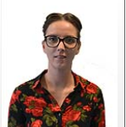
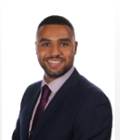
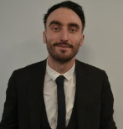
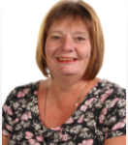
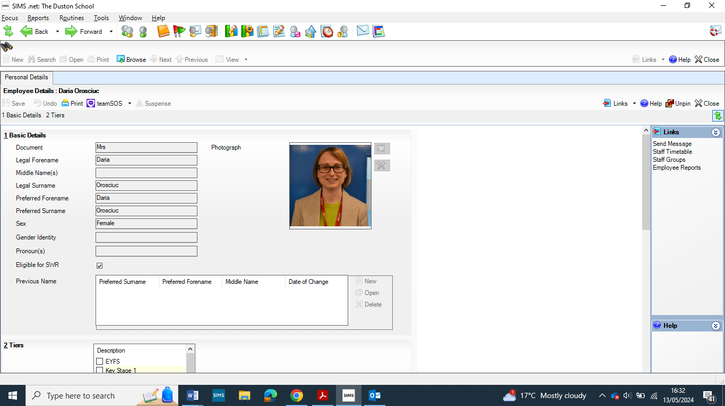
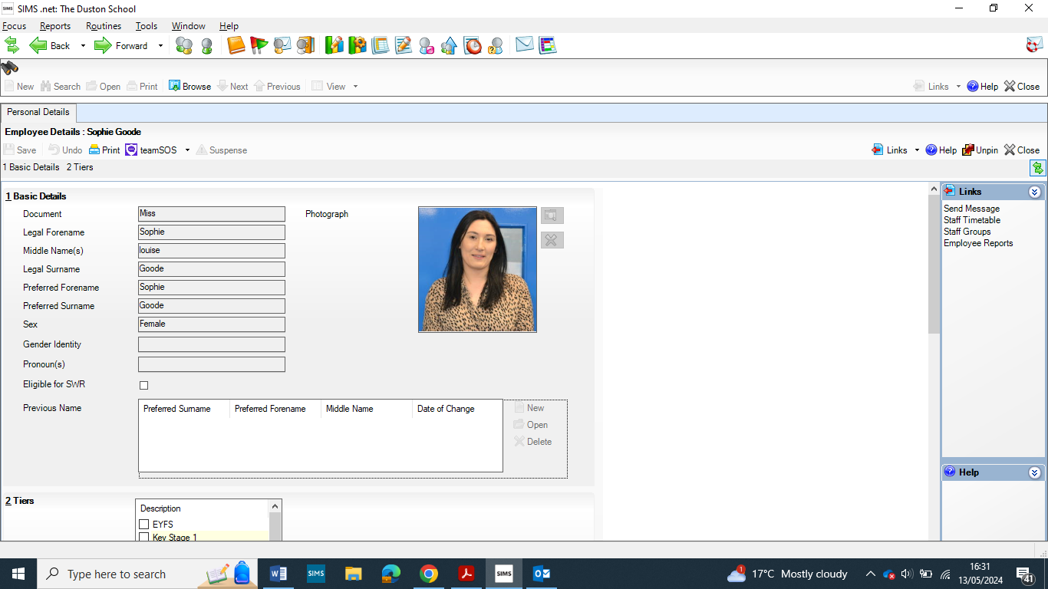
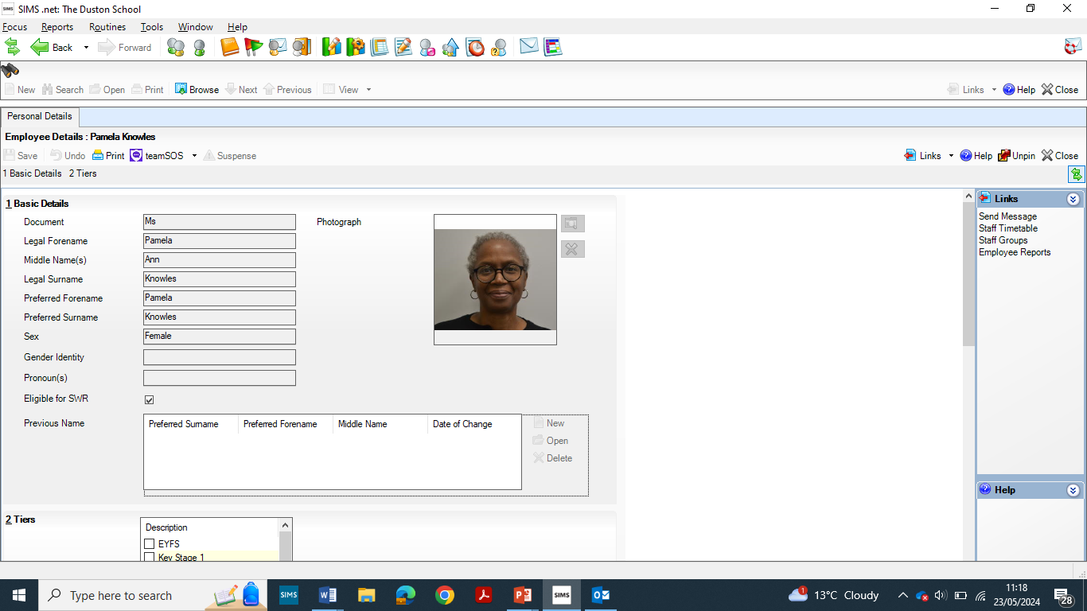
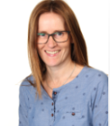
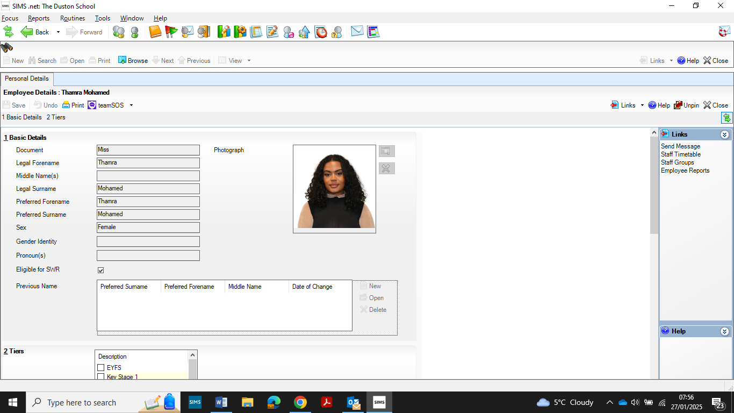
PIC STAFF
Miss Nicola O’Brien
Positive Impact Centre Manager
Deputy SENCO
Mr Sam Leighton
Deputy Positive Impact Centre Manager
Mr Kolby Johnson
Behaviour Management Lead
Mrs Sally Threadgold
HLTA
Mrs Daria Orosciuc
EAL Co-ordinator
Miss Sophie Goode
Counsellor
Mrs Pamela Knowles
HLTA
Mrs Elizabeth Davis
Counsellor
Miss Tam Mohammed
Counsellor

Slide 3
7 Strands of Impact
Alternative Provision for KS3 pupils
(up to 12 week Full-time programme)
Counselling Service
(Targeted support)
1
4
Wellbeing Interventions
(Short term focus groups/1-1 sessions)
Peer Mentoring
Mental Health
CAMHs/MHST
Lowdown/Service Six
2
5
Parenting Pathway
Solihull Approach
3
6
RESET – Intensive Behaviour Intervention
Regulation
Engagement
Support
Empowerment
Transformation
7
English as an additional Language
(EAL)

