Slide 1

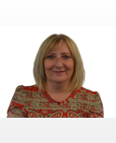

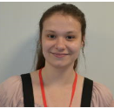
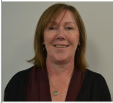

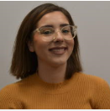
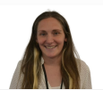
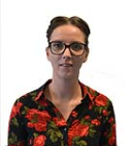

Welcome to the TDS SEND Team
Natalie Adams – Strategic Lead for SEND
We are delighted to introduce you to our SEND team and their roles:
The Duston School is a mainstream provision. This means that:
Students' needs are mainly met in normal timetabled lessons.
The SEND team provide classroom teachers with information on the needs of individual students.
The SEND team support classroom teachers by providing advice, training and strategies that they need to support individual students.
Where an emerging student need is identified and supported with evidence, the SEND team will carry out relevant assessments to identify an area of need.
Any adjustments, support or access arrangements that are put in place for an individual student will be evidence based i.e. a diagnosis/report from a professional.
Where a need is identified, following recommendations from specialised professionals, targeted interventions will be provided for individual students to support these recommendations.
HLTA’s will provide bespoke support for students who have an Education Health and Care Plan (EHCP) with the frequency of support dependant on the provision outlined in the EHCP.
Introduction of a SEND Hub to support student needs.
Kelly Gower – HLTA for Cognition and learning needs
Ashley Thomson – SENDCo
Angel Driscoll – HLTA for Communication and Interaction, Sensory/Physical needs.
Sharon Wass – Deputy SENDCo
Holly Barron – HLTA for Social, Emotional and Mental Health
Donna Gioia – Deputy SENDCo
Tiffany Finch – SEND Administrator
Nicola O’Brian – Deputy SENDCo

