Slide 1


Alternative Academic Qualification (AAQ)
Health & Social Care
Introduction to Sixth Form
Name: ______________________

Slide 2
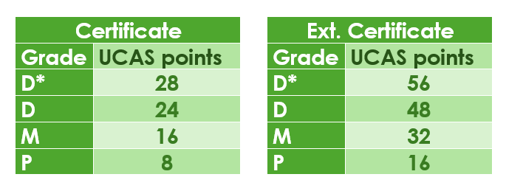
What will I be studying?
Health and social care is a subject that has many topic areas and is a good foundation subject for a wide range of careers.
In general, it’s about people, their health, individual circumstances and what affect individuals.
Your learning will explore what healthcare and social care service there are and how different job roles support people to meet their individual needs.
First year – Certificate
One exam assessed unit – Principles of health and Social Care
Two supervised assignments called NEA’s (non-examined assessment)
The NEAs are; Person-centred care and Supporting people with mental health conditions
You will have an opportunity to resit your exam and there will be a chance to improve some of your assignment work
Second year – Extended Certificate
One exam assessed unit – Anatomy & Physiology for health and social care
Two supervised assignments called NEA’s (non-examined assessment)
Your teacher will deliver the course content using a wide range of teaching methods.
You will have a booklet which you will be using in lessons and, a completed booklet at the end of the unit for revision or NEA practice. You can monitor your own learning through tick off the content as you go along .
You may be considering a career which requires a university degree and are thinking about UCAS points for the AAQ.

Slide 3













What the Health
Louis Theroux: Extreme love, Dementia
Babies
Five Feet Apart
Theory of Everything
Humans;
Body Systems
Three identical strangers
Brain on Fire
The Game Changer (2018)
Girl, interrupted
Call the Midwife
13 Reasons Why
Recommended Watching for Health & Social

Slide 4


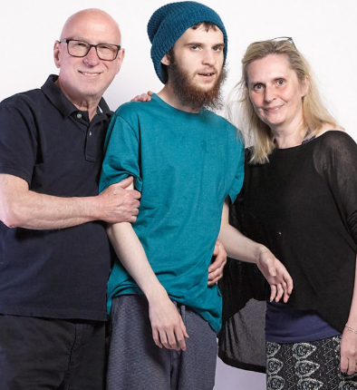


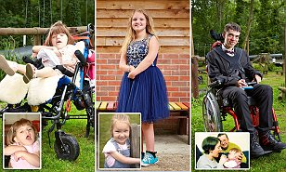
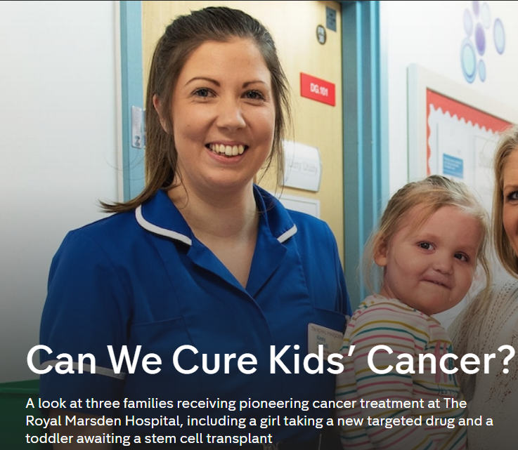





Not
Rhod Gilbert's Work Experience
Katie Price; Harvey and Me
Inside our Minds
Stacey Dooley 9-5 Care Home
BBC iPlayer
24 hours in A&E
Born to be different
The Royal Marsden
Losing it: Our mental health
All 4
Beyond weight loss
The Upside
ALLELUJAH
Miss you Already
Amazon Prime

Slide 5





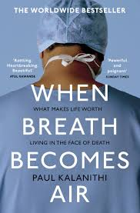








Dive into a book
Pig Heart Boy by Malorie Blackman
The Illustrated Mum Jacqueline Wilson
This is Going to Hurt by Adam Kay
When Breathe becomes Air by Paul Kalanithi
Further Reading
The Hate U Give by Angie Thomas
Me Before you by Jojo Moyes
The Fault in Our Stars by John Green
The Story of Baby P by Ray James
The Language of Kindness by Christie Watson
I am Malala by Malala Yousafzai
The Perks of Being a Wallflower Stephen Chbosky
Katie Price; Harvey
Recommended Reading for Health & Social Care
Yes, some of these are also films, if you prefer!

Slide 6



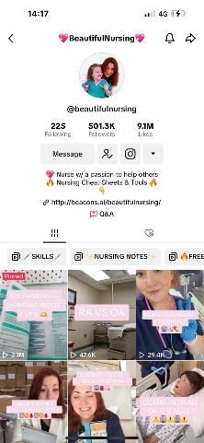

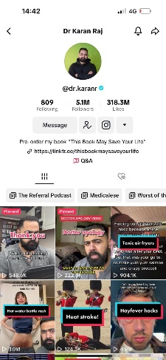
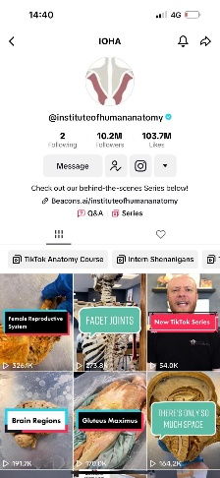

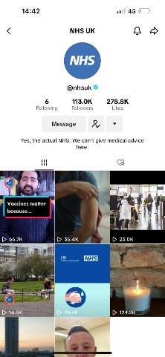


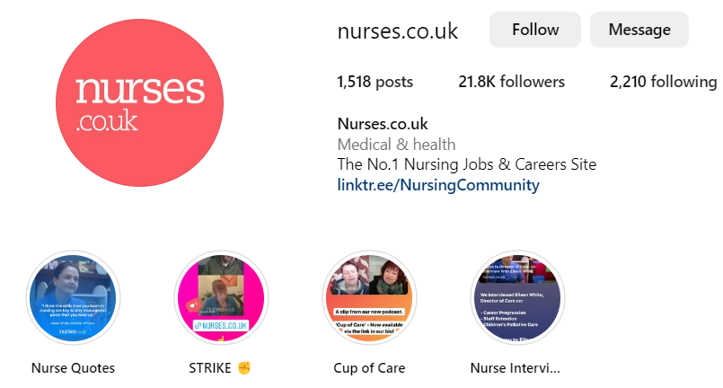
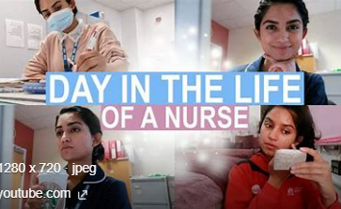
Social Media
Follow
Follow
@midwifemama
@beautifulnursing
@leilaincredible
@dr.karanr
@instituteofhumananatomy
@lubdubsblog
@nhsuk
@alliedhealthcareforme
Nurses.co.uk
@nursezara_uk
If you have any others, you think are good, let us know ☺

Slide 7


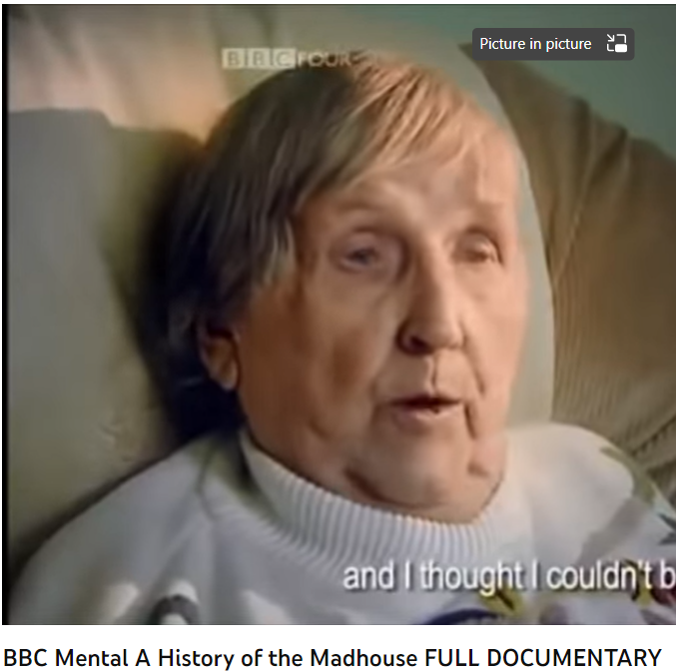
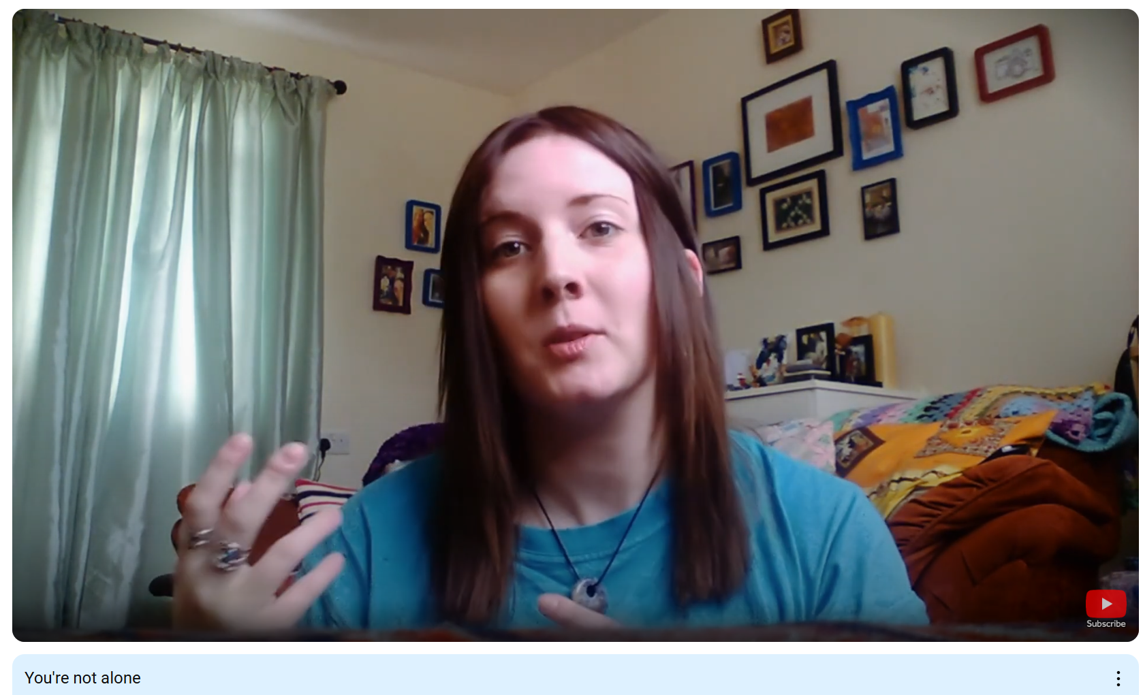
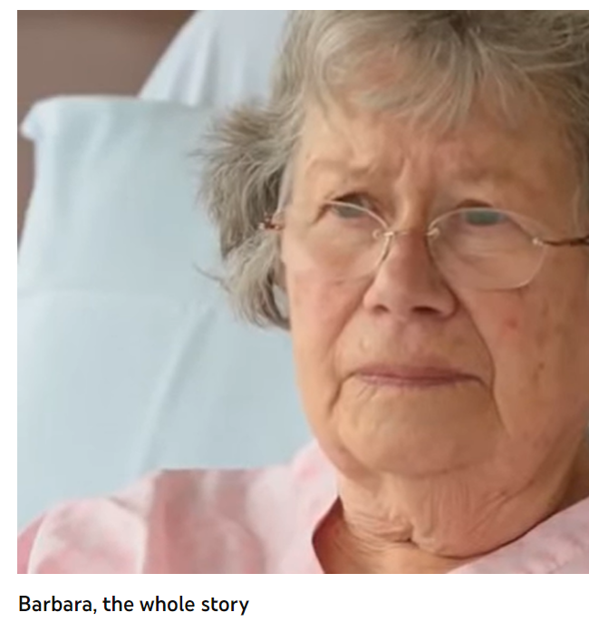
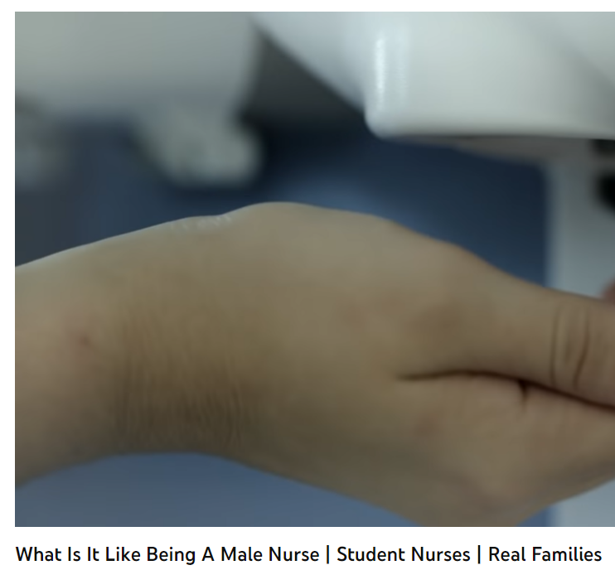
Health and Social Care in the Media
It is important to have a broad understanding of health care and social issues which affect services and professionals working for the NHS. One way of raising your awareness is to prepare you before your course starts with summer learning using different forms of media.
Your task is to pick…
➢ 2 Films
➢ 2 Documentaries
Consider the following:
What issues, if any, are being raised in the stimulus? E.g. dementia
How does the stimulus present health? E.g. care for people with dementia
Explain why the topic of the media source is relevant to your learning and whether you think it is helpful and why?
This list is NOT exhaustive there may be other questions/ideas you wish to consider as you watch or read – it would be lovely to share with us all.

Slide 8
Learning Log
Record here any additional reading/viewing you are undertaking in order to show what you have been completing in order to prepare you for the course. Use the reading list on the previous slides you have been given for guidance on what you could you watch/read/research
Date | Title | Summary of content | My thoughts

