Slide 1
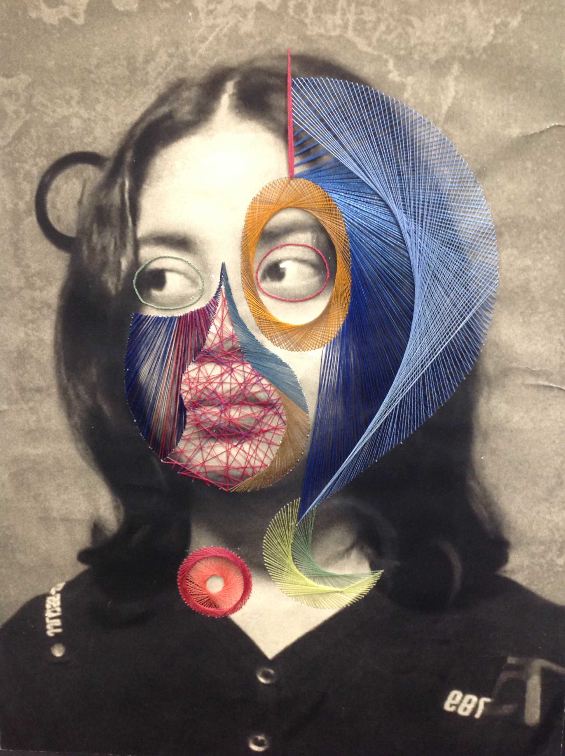
Fine Art
A Level Course Preparation

Slide 2
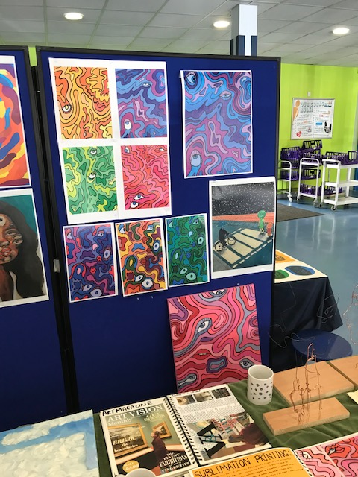
Resource List
You will need to purchase an A3 sketchbook for your studies. Try to get a good quality cartridge paper such as 130gsm as this will support a wider range of media such as paint, materials and collage in addition to drawing.
Please see below for a full list:
Recommended Items
Quality paintbrushes for watercolours, acrylics and/or oils
Acrylic paint starter set
Oil paints & Linseed Oil (some provided by the school)
Watercolour paints (some provided by the school)
Designers Gouache paint (some provided by the school)
Soft coloured pencils (watercolour pencils are easy to blend)
Oil pastels
Soft (chalk) pastels
Putty Rubber
Drawing blending/smudging stick
A2/A3 portfolio
Essential Items
A3 sketchbook – quality cartridge paper (preferably hardback/thick card cover)
Drawing pencils – minimum 2H, HB, 2B, 4B
Writing Pens
Eraser
Sharpener
Glue stick

Slide 3
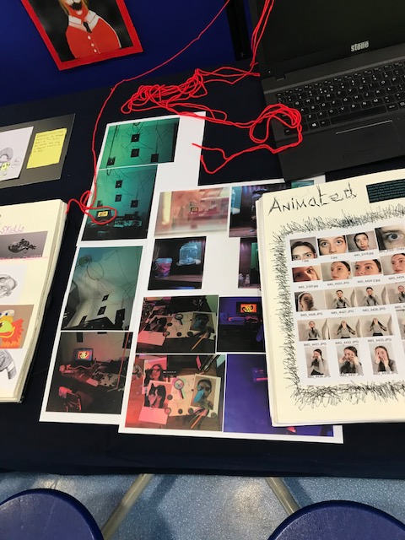
Course Overview and Project Selection
Year 12 will predominantly serve as an introductory year whereby you will explore a broad range of media, techniques and processes. There will be teacher-led workshops, personal investigation and ideas development based around a self-selected theme or ‘starting point’.
Please select from one of the following themes:
Animals
The Human Form
Parts and Sections
Buildings and Structures
Landscapes
Natural Forms
Still Life
These themes are intended as a starting point to your project and are likely to adapt and change as your project develops.
You may have a clear idea about what you intend to research or not. At this stage, produce a rough initial mind map with the theme in the centre and potential ideas for development. You can include artists/designers/illustrators/photographers on the mind map too.

Slide 4
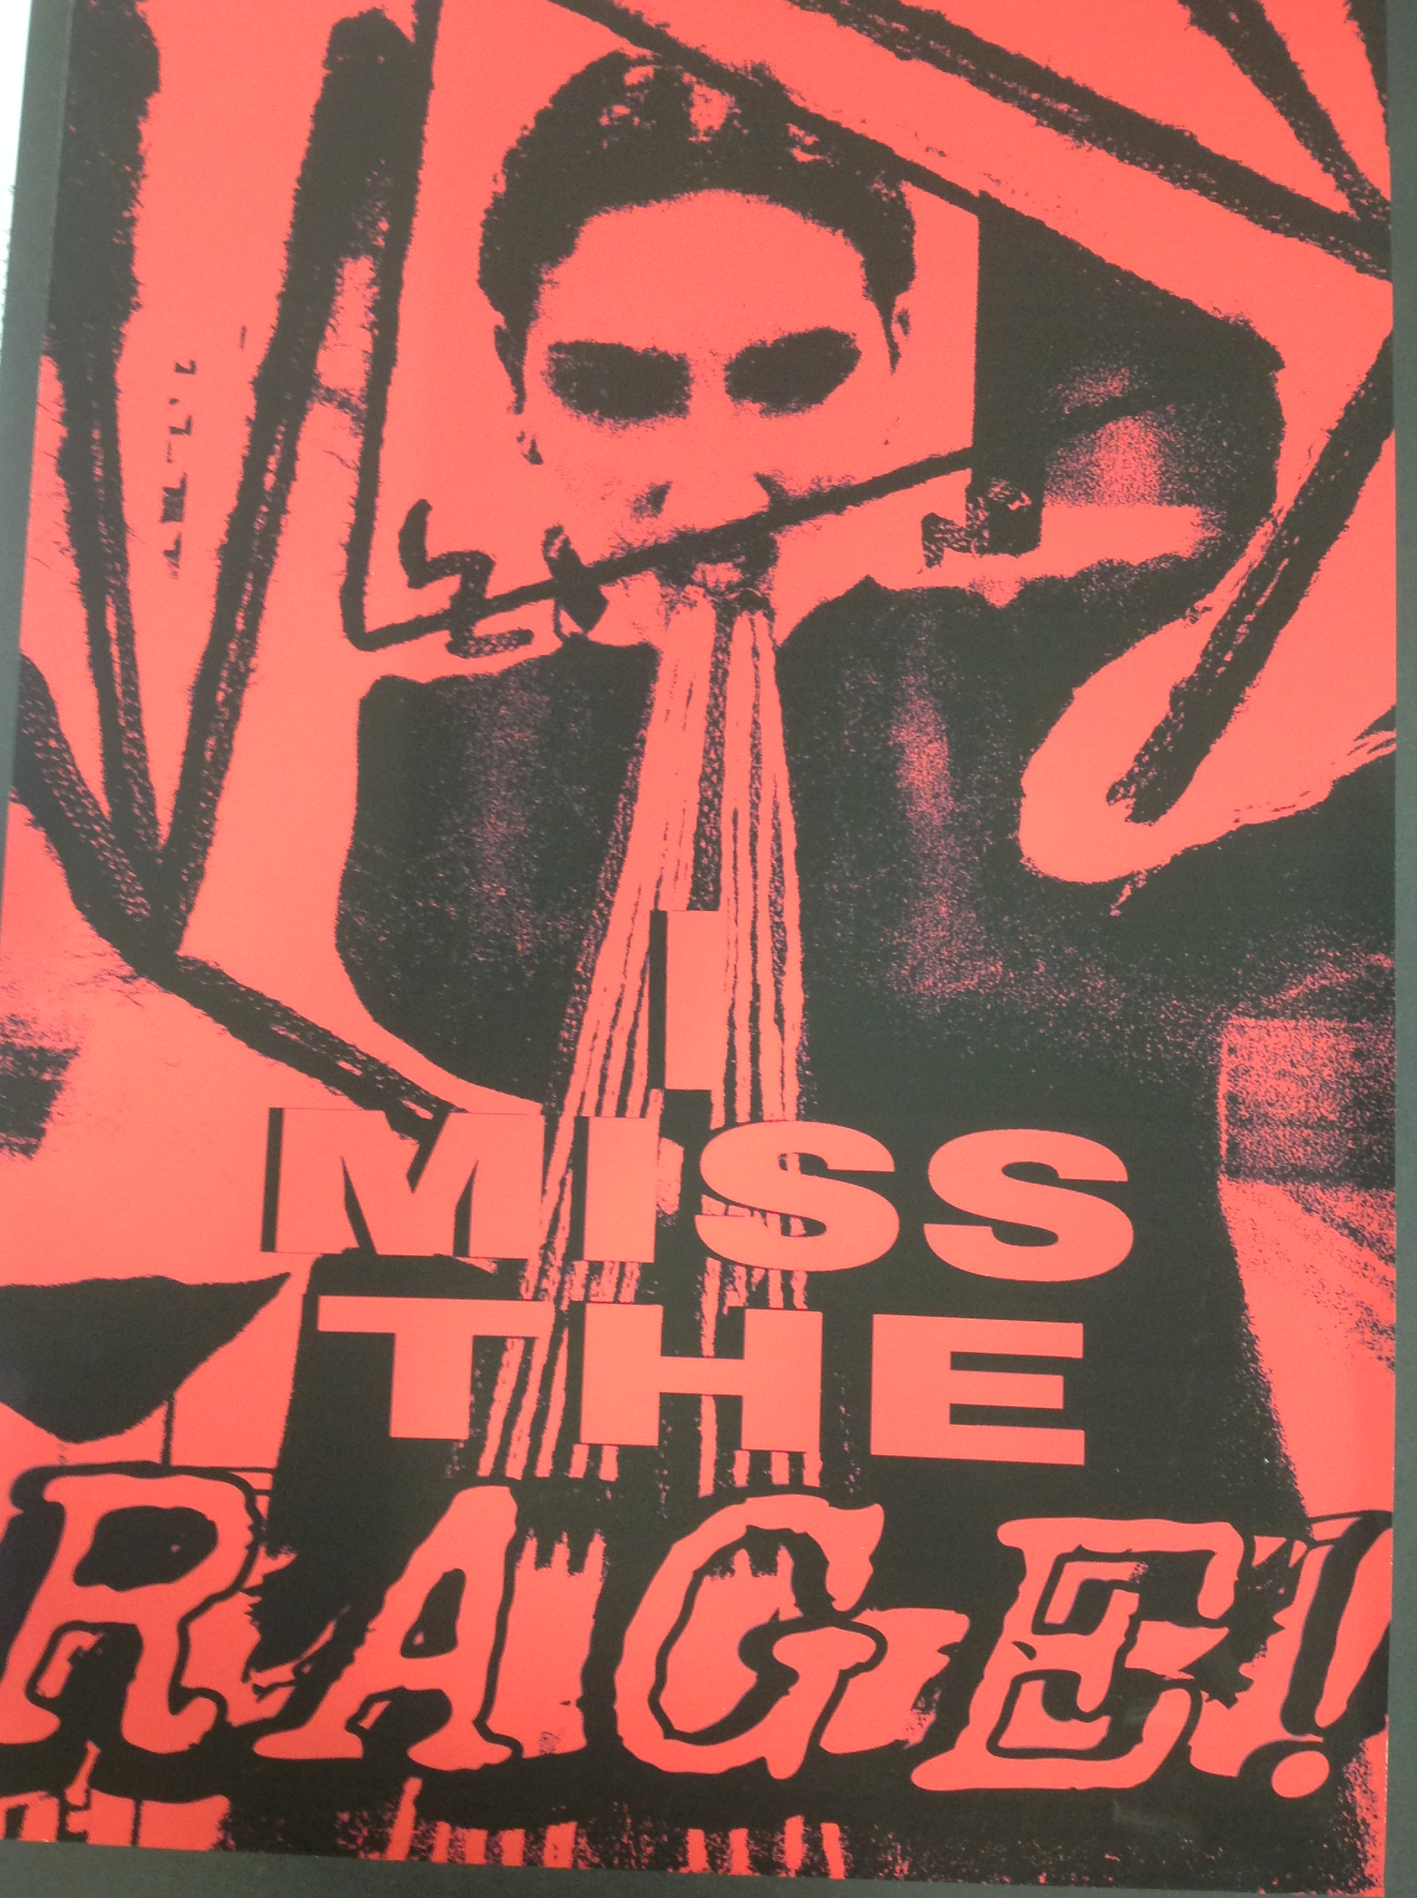
Holiday Preparatory Tasks:
Title Page, Resource Gathering and Sketches:
Produce a title page for your project on the first page of your sketchbook. This needs to include the title in a lettering style of your choice and one or more images drawn/painted/collaged by you in a medium of your choice
Take 5-10 good quality photographs relating to your chosen theme and print these in colour (each image roughly ¼ of a page of A4 or 5x7 prints if they are printed as photos)
Produce 6 x A6 sketches from your chosen photos or direct observation using media of your choice (eg pencil, pen, paint, multi-media)

