Slide 1

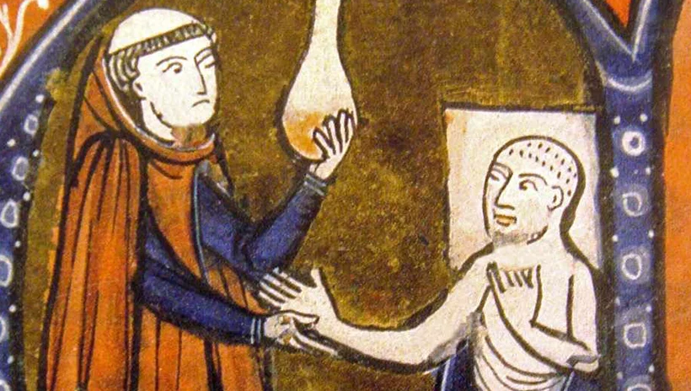
GCSE Medicine knowledge organiser.
Name:
Class:

Slide 2
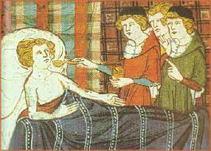
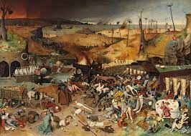
Big Questions: Key Topic 1
c1250-c1500 - Medicine in Medieval England.
BQ1: How did people in the Middle Ages explain the causes of disease and illness?
BQ2: Why was there so little change in the causes of disease and illness 1250-1500?
BQ3: How did people in the Middle Ages treat disease and illness?
BQ4: How did people in the Middle Ages prevent disease and illness?
BQ5: How was the Black Death dealt with?
Medieval England was not an easy place to live in. Most of England’s population worked in the fields, growing and harvesting crops for wealthy landowners. Poor nutrition, particularly at times of famine when food was scarce, and hard physical labour, meant that sickness and disease were never far away. Some people lived in towns and cities, but this was not much better than the country: the crowded streets and lack of drains meant diseases spread easily. Homes were heated by open fires, and being exposed to smoke every day meant lung diseases were common. Nearly half of the population died before reaching adulthood.
There was not much scientific knowledge in medieval England. People were not looking to science to cure diseases and ailments at all. Instead, the Catholic Church used ancient texts, written by leading doctors and physicians such as Hippocrates and Galen, to explain why people caught diseases – or they said it was God’s will when somebody became ill. People believed God could send diseases – or they said it was God’s will when somebody became ill. People believed God could send disease as a punishment for sinful behaviour.
Most of the time, this explanation was enough. Only in times of terrible diseases, such as during the Black Death in 1348, did people start to question the authority of the Catholic Church on matters of medicine.

Slide 3

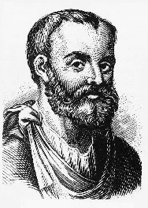

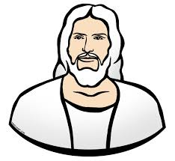
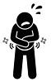









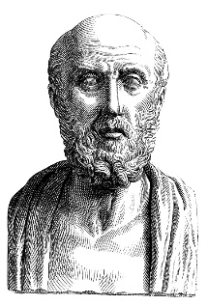


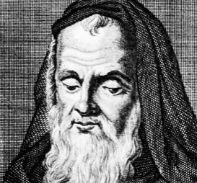
Key Dates:
1278 – Roger Bacon imprisoned by the Church
1348 – The Black Death arrives in Britain
1470s – The printing press arrives in Britain
GCSE History Knowledge Organiser: Medieval Medicine, 1250-1500
Physicians learned from Galen’s work
God sends disease to punish humanity
Church supports Galen’s ideas
Dissections on humans rare – only carried out to prove Galen correct
→
Church
Education
Books copied out by hand
King’s main duties – upholding law, defending the country
REASONS FOR LACK OF CHANGE IN MEDICINE
Government
People reluctant to question traditional ideas
Conservative Attitudes
Individuals
?
Taxes not spent on public health
Fear of Hell
Hippocrates
Galen
Roger Bacon

Slide 4





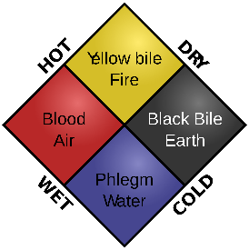







Keywords:
Miasma:
Bad air that was believed to cause sickness
Four Humours:
The theory that imbalanced humours caused sickness
God’s Punishment:
The belief that people became sick because God punished them for their sins
Flagellants:
People who whipped themselves to show God they were sorry
Rakers:
People paid to sweep towns’ streets
Regimen Sanitatis
Instructions given by physicians for keeping healthy: included moderate exercise and not over-eating
GCSE History Knowledge Organiser: Medieval Medicine, 1250-1500
HEALERS IN THE MIDDLE AGES
Physician
Apothecary
Barber Surgeon
Women
FEATURES OF MEDIEVAL MEDICINE
CAUSES
=
God’s Punishment
Imbalance of Humours
Miasma
TREATMENT AND PREVENTION
Posies
Incense
Rakers
Prayer
Fasting
Flagellation
Bloodletting
Purging/
Laxatives

Slide 5

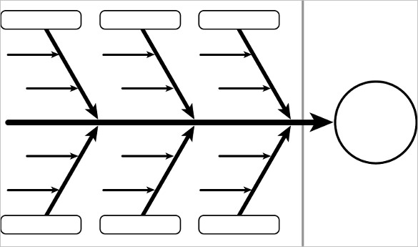
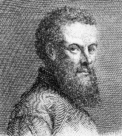

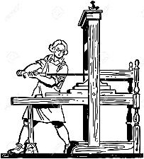
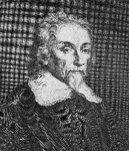

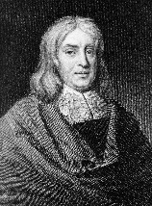

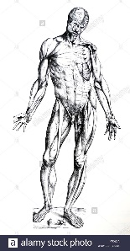


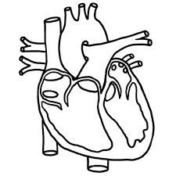
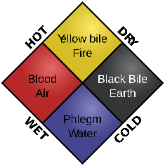


Key Dates:
1470s – The printing press arrives in Britain
1543 – Vesalius publishes Fabric of the Human Body
1628 – William Harvey publishes his work on the circulatory system
1660 – The Royal Society is founded
1665 – The Great Plague in London
1676 - Thomas Sydenham publishes Observationes Medicae
1683 - Anton van Leeuwenhoek discovers bacteria but nobody realises their significance
GCSE History Knowledge Organiser: Renaissance Medicine, 1500-1700
Individuals
Progressive Attitudes
Technology
Andreas Vesalius
Public dissections
Printing Press
Royal Society
Mechanical Pumps
William Harvey
Thomas Sydenham
Scientific Method
Why was there progress in medical knowledge BUT continuity in treatment and prevention?
God’s Punishment
Continuing respect for Galen’s ideas
=
Four Humours
Miasma
Influence of the Church
Anatomical discoveries did not further understanding of causes
Lack of Knowledge
Conservative Attitudes

Slide 6
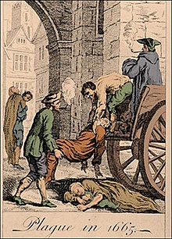
Big Questions: Key Topic 2
C1500-c1700 - The Medical Renaissance in England.
‘Renaissance’ is a French word that means rebirth. The Medical Renaissance refers to a period when new ideas were beginning to influence medicine.
These new ideas were slowly breaking down old beliefs and rethinking the way the world worked. At this time, Protestantism challenged the teachings of the Catholic Church – this made the Catholic Church much less able to promote its preferred beliefs about science and nature.
Scientists provided evidence that the Greek teachings about how the world worked were incorrect. Vesalius, a doctor working in Padua, proved through dissection that Galen’s work on anatomy was wrong. Although these ideas took a long time to become widespread, the new printing presses meant that they could be published and spread even though they went against the teaching of the Church.
Between the years 1500 and 1700, there were certainly a lot of new, exciting ideas. However, the impact that these ideas had on medical treatments during this period was minimal. It took a long time for people to let go of their old, trusted beliefs about the Theory of the Four Humours. Therefore, the period was more about laying the foundations for changes in medicine to come, rather than changes in medicine at the time.
BQ1: How did people in the Renaissance period explain the causes of disease and illness?
BQ2: Why did ideas about the causes of disease change during the Renaissance period?
BQ3: How did people during the Renaissance period treat and prevent disease and illness?
BQ4: How did people during the Renaissance period care for sick people?
BQ5: To what extent were Vesalius and Harvey influential in changing ideas about medicine during the Renaissance period?
BQ6: How did people deal with the Great Plague in London, 1665 (case study).

Slide 7
Key Dates:
1470s – The printing press arrives in Britain
1543 – Vesalius publishes Fabric of the Human Body
1628 – William Harvey publishes his work on the circulatory system
1660 – The Royal Society is founded
1665 – The Great Plague in London
1676 - Thomas Sydenham publishes Observationes Medicae
1683 - Anton van Leeuwenhoek discovers bacteria but nobody realises their significance
GCSE History Knowledge Organiser: Renaissance Medicine, 1500-1700
Individuals
Progressive Attitudes
Technology
Andreas Vesalius
Public dissections
Printing Press
Royal Society
Mechanical Pumps
William Harvey
Thomas Sydenham
Scientific Method
Why was there progress in medical knowledge BUT continuity in treatment and prevention?
God’s Punishment
Continuing respect for Galen’s ideas
=
Four Humours
Miasma
Influence of the Church
Anatomical discoveries did not further understanding of causes
Lack of Knowledge
Conservative Attitudes

Slide 8




Keywords:
Miasma:
Bad air that was believed to cause sickness
Four Humours:
The theory that imbalanced humours caused sickness
God’s Punishment:
The belief that people became sick because God punished them for their sins
Phlebotomy:
Bleeding a patient whose humours are unbalanced
Rakers:
People paid to sweep towns’ streets
Plague Doctor
Doctors who specialised in the plague. Their ‘beaks’ were stuffed with lavender
GCSE History Knowledge Organiser: Renaissance Medicine, 1500-1700
HEALERS IN THE RENAISSANCE
Physician
Apothecary
Barber Surgeon
Women
FEATURES OF RENAISSANCE MEDICINE
CAUSES
=
God’s Punishment
Imbalance of Humours
Miasma
TREATMENT AND PREVENTION
Plague Doctor
Burning Tar
Tobacco
Prayer
Fasting
Pilgrimmage
Bloodletting
Purging/
Laxatives

Slide 9
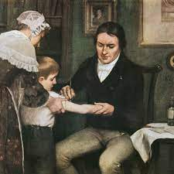
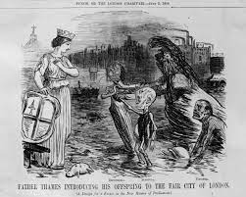
Big Questions: Key Topic 3
C1700-c1900 - Medicine in 18th and 19th century Britain.
BQ1: How did people in the 18th and 19th centuries explain the causes of disease and illness?
BQ2: How did people in the 18th and 19th centuries treat illness and disease?
BQ3: What improvements were there to surgery during the 18th and 19th century?
BQ4: How did people try to prevent disease and illness during the 18th and 19th century?
BQ5: How did the government try to fight cholera in 1854?
From the start of the 18th century, rapid changes began to occur in medicine. Between 1500 and 1700, many new medical theories had been published: however, it was not until later that those theories were put into practice.
At the start of the period c1700-c1900, the Theory of the Four Humours was no longer widely believed, but it had not yet been replaced by anything else. Bleeding and purging were still common treatments. Apothecaries still sold herbal remedies and most treatment was still carried out by women in the home. Luckily, epidemic diseases such as the plague seemed to have disappeared, but smallpox and other diseases were common.
By 1900, the medical landscape had been completely transformed. Germs had been discovered, and there was ongoing work to create vaccines and develop treatments for the disease caused by them.
Edward Jenner had developed the first vaccination for small pox – and a British government more willing to get involved in day-to-day life had made this vaccination compulsory in 1852.
Hospitals had been developed into clean, modern institutions, thanks to the work of Florence Nightingale. Developments in anaesthetics and antiseptics meant that surgery was now much less dangerous, and therefore much more common.

Slide 10










Keywords:
Miasma:
Theory of “Bad Air”
Cholera:
Waterborne disease
Bacteriology:
Study of micro-organisms
Inoculation:
‘Live’ bacteria used to create anti-bodies
Vaccine:
Weakened version of bacteria to create anti-bodies
GCSE History Knowledge Organiser: Growing understanding of the Causes of Disease in the Industrial Period
1796
1854
1861
1882
1885
Edward Jenner
John Snow
Louis Pasteur
Robert Koch
Louis Pasteur
Developed Germ Theory, encouraged government to make smallpox vaccines compulsory
Discovered vaccine for Smallpox, making inoculation obsolete
Proved cholera transmitted by dirty water
Bacteriology, used chemical dyes to identify bacteria
Developed a vaccine for rabies, led to vaccines for other diseases

Slide 11
















Keywords:
Laissez-faire:
Idea of non-interference by government
Pension:
Money from govt for those 65+
National Insurance:
Part of workers wages went to guarantee sick pay
Welfare State:
Govt using tax money to look after various groups in society.
NHS:
Abbreviation for National Health Service
GCSE History Knowledge Organiser: Improvements to Public Health in the 19th and 20th Centuries
Public Health Act – councils could…
Appoint a local medical officer
Provide clean water
1848
1858-1865
‘Great Stink’ in London (1858)
Joseph Bazalgette built 1,300 miles of sewers in London by 1865
Second
Reform Act
Increased the number of men who could vote in elections
1867
Provide clean water
Dispose of sewage properly
Inspection of new houses
Public Health Act – councils had to…
1875
1906 – Free School meals
1908 – Old Age Pensions
1911 – National Insurance – Sick pay and maternity benefit
National govt led
New Liberal govt focus = people
1910’s
NHS formed –
Based on Beveridge Report (1942)
1948

Slide 12
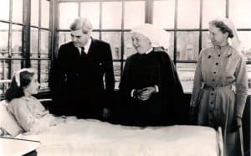

Big Questions: Key Topic 4
C1900-present - Medicine in Modern Britain.
By 1900, all the pieces were in place to build a better approach to assessing and managing human health. People now understood that illness and disease could be caused by microbes, and scientists had begun to experiment with ways of treating and preventing diseases using this new knowledge.
Scientists began to investigate causes of disease that were not related to microbes. Genetics and lifestyle factors were investigated as other potential factors.
Chemical treatments were developed to target specific diseases, while antibiotics were discovered that could treat a whole range of illnesses that previously might have been fatal. Advances in surgical techniques made available life-saving treatments such as transplants.
The British government also developed a new attitude towards its role in the nation’s health. Free medical care was provided for all through the National Health Service.
Unfortunately, understanding more about the cause of disease and illness has made us realise how much there is still to discover. Diseases such as cancer continue to puzzle scientists, who struggle to understand their cause of develop treatments for them. Lifestyle factors such as obesity have created new challenges for medicine to tackle.
BQ1: How did people explain the causes of disease and illness from 1900-present?
BQ2: How did people from 1900 treat disease and illness?
BQ3:How did people try to prevent disease and illness after 1900?
BQ4: How did the care of sick people change after 1900?
BQ5: How have the government dealt with the fight against lung cancer in the 21st century?

Slide 13

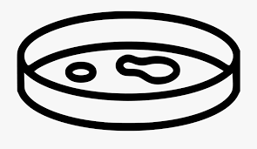


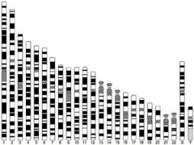




Keywords:
Magic Bullet
A chemical treatment that kills bacteria
Antibiotics
A drug made from bacteria that kills other bacteria and so cure an infection
DNA
The genetic ‘instructions’ that determine how your body works and looks
National Health Service
Provides healthcare in Britain which is free at the point of delivery for all
GCSE History Knowledge Organiser: Growing understanding of the Causes of Disease in the 20th century
Germs
1909
1928
1941
1955
Paul Ehrlich and Hata
Alexander Fleming
Florey and Chain
Jonas Salk
Penicillin is trialled on a policeman, with some success and then mass-produced
Developed a polio vaccine
Created first magic bullet, Salvarsan 606
Fleming identifies penicillin in his lab
Genetics
1951
1953
1990s
Rosalind Franklin
Crick & Watson
Human Genome Project
Images of DNA created by using x-ray crystallography
Discovered the double-helix structure of DNA
Human genome mapped
Lifestyle
1901
1942
2007
Seebohm Rowntree
William Beveridge
Parliament/
Public Health England
Proved a link between poverty and disease
Beveridge identified 5 ‘giants’ to be defeated – ‘Want, Disease, Ignorance, Squalor and Idleness’
Smoking in public places banned

Slide 14

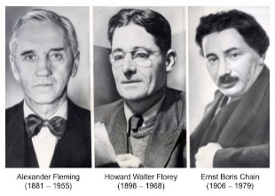


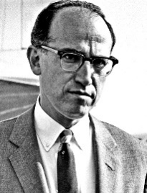



Keywords:
Mass Production:
The production of large numbers of items using assembly lines
Penicillin:
An antibiotic drug used to treat a number of infections
Endoscope:
A flexible camera used to see inside the body
Radiotherapy and Chemotherapy:
Cancer treatments based on nuclear science
GCSE History Knowledge Organiser: Reasons for Rapid Progress in Medicine in the 20th Century
Government
Technology
Individuals
Mass Production
Fleming, Florey
and Chain (pencillin)
Scans and monitors
Jonas Salk (polio vaccine)
Huge government spending on health
Why was there rapid progress in treatment and prevention during the 20th century?
International community of scientists
People wanted a better future after war
…of Germ Theory
Collaboration
between scientists
…of genetics and DNA
Need for penicillin during war
…of the impact of lifestyle
Attitudes
Knowledge
War

Slide 15
Keywords:
Magic Bullet
A chemical treatment that kills bacteria
Antibiotics
A drug made from bacteria that kills other bacteria and so cure an infection
DNA
The genetic ‘instructions’ that determine how your body works and looks
National Health Service
Provides healthcare in Britain which is free at the point of delivery for all
GCSE History Knowledge Organiser: Growing understanding of the Causes of Disease in the 20th century
Germs
1909
1928
1941
1955
Paul Ehrlich and Hata
Alexander Fleming
Florey and Chain
Jonas Salk
Penicillin is trialled on a policeman, with some success and then mass-produced
Developed a polio vaccine
Created first magic bullet, Salvarsan 606
Fleming identifies penicillin in his lab
Genetics
1951
1953
1990s
Rosalind Franklin
Crick & Watson
Human Genome Project
Images of DNA created by using x-ray crystallography
Discovered the double-helix structure of DNA
Human genome mapped
Lifestyle
1901
1942
2007
Seebohm Rowntree
William Beveridge
Parliament/
Public Health England
Proved a link between poverty and disease
Beveridge identified 5 ‘giants’ to be defeated – ‘Want, Disease, Ignorance, Squalor and Idleness’
Smoking in public places banned

Slide 16
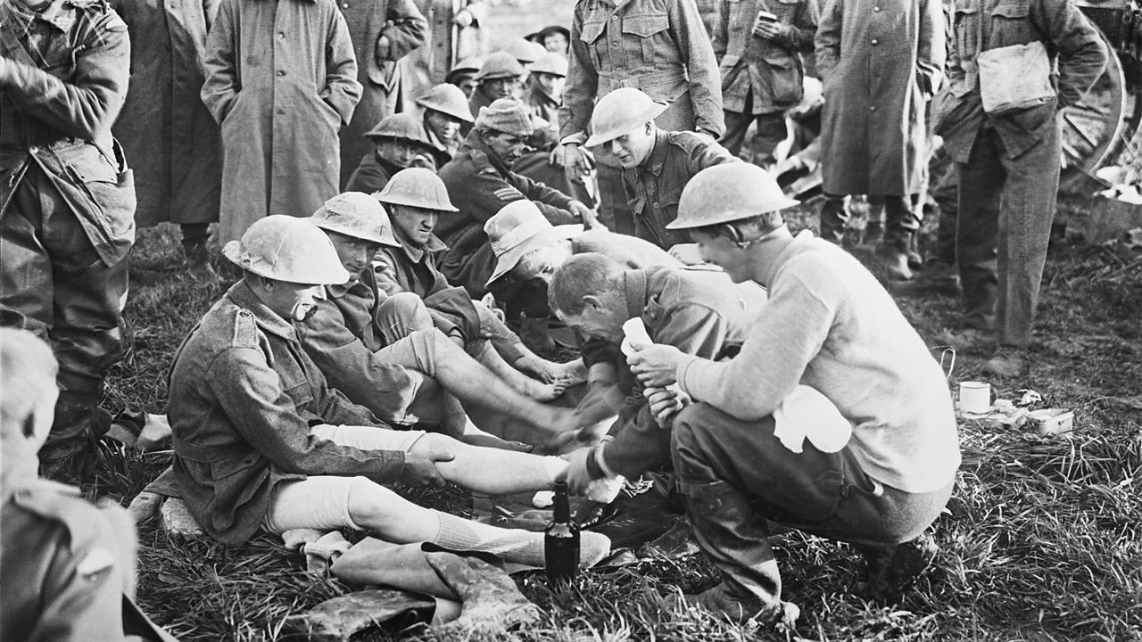
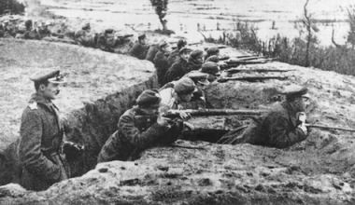
The British sector of the Western Front, 1914-1918: Injuries, treatments and the trenches.
BQ1: What was medicine like before World War One?
BQ2: How did the trench system work?
BQ3: What were the key battles of World War One?
BQ4: Why did the British face problems with transport and communication on the Western Front?
BQ5: What injuries and illnesses did soldiers face on the Western Front?
BQ6: What was the chain of evacuation process and how effective was it?
BQ7: Why did surgery and medicine improve after World War One?
British soldiers fought in the trenches along the Western Front between 1914 and 1918, during the First World War.
If you had been a soldier in the British sector of the Western Front in France and Flanders, you would have been in danger from many different things. Whilst fighting for king and country, you would have faced dangers from shelling, grenades, gas and hand-to-hand combat. Disease – both in the body and the mind – also threatened you, as you lived in the trenches. It would not be unusual to be in a frontline trench, under constant bombardment, for up to a month.
You might be one of the 2.7 million casualties in the British sector of the Western Front during the four years of fighting. Of this number, about ¼ were not seen by medical services, because they were either killed or taken prisoner – this totalled around 700,000 men. The remaining two million men were treated by medical services in France or back in England. The scale of medical treatment for wounded soldiers was vast.
Of those casualties seen by medical services, 5.6% died from the wounds that they suffered. Although this means that more than 150,000 soldiers died after receiving medical care, it also means that the vast majority of those treated survived their wounded and illnesses. This is a testament to the successes of medical care during the First World War.

Slide 17













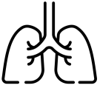




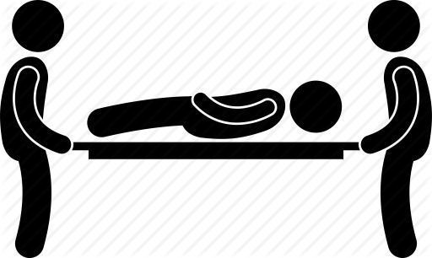

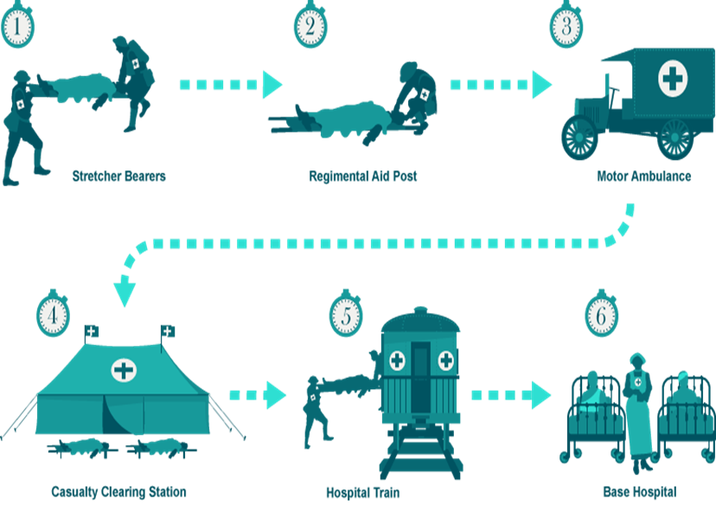

Key Dates:
Autumn 1914 – First Battle of Ypres
Spring 1915 – Second Battle of Ypres
1916 – Battle of the Somme
1917 – Battle of Arras
1917 – Battle of Cambrai
GCSE History Knowledge Organiser: Surgery on the Western Front, 1914-1918
Shrapnel Wounds
X-Rays
Carrel-Dakin Method
60
Disfigurements
and Burns
Head
Plastic Surgery
Trench Fever
Improvements in Treatment
Injuries
World War I, 1914-1918
Blood Bank/ Transfusion
Trench Foot
Gas
Thomas Splint
Skin Grafts
Fractures
The Evacuation Route
Stretcher Bearers
Regimental Aid Post
Field Ambulance and Dressing Station
Casualty Clearing Station
Base Hospital

Slide 18

How would I answer the exam questions?
The Medicine paper consists of two sections:
Section A
(worth 16 marks)
The British sector of the Western Front, 1914-1918.
Section B
(worth 36 marks) Medicine through time.
The paper is 1 hour 15 minutes in total.
Section A – The British sector of the Western Front, 1914-1918.

Slide 19
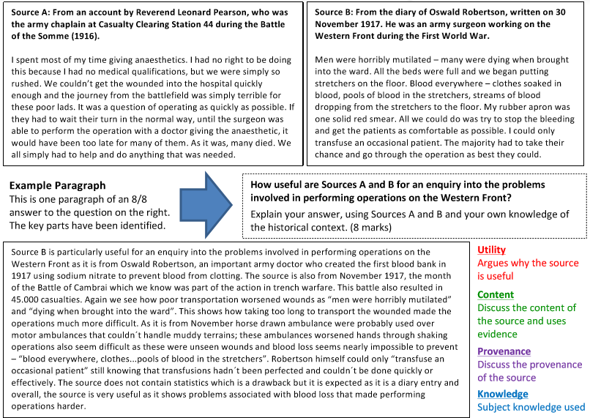
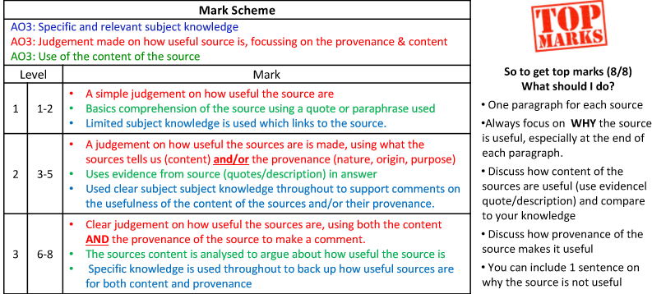
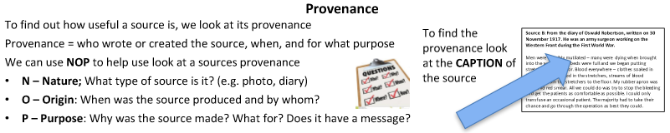
How would I answer the exam questions?

Slide 20
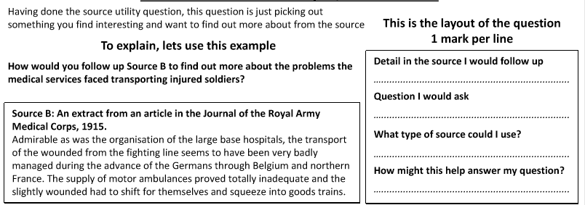
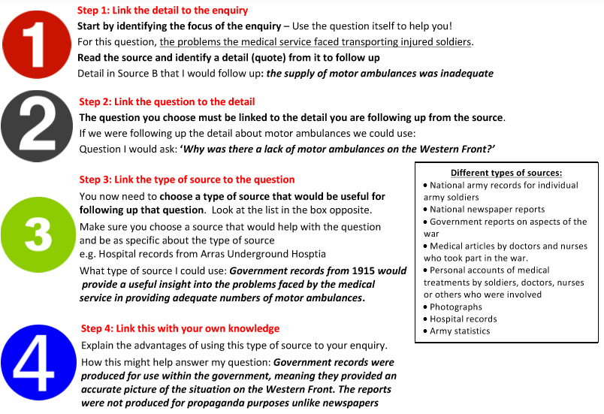
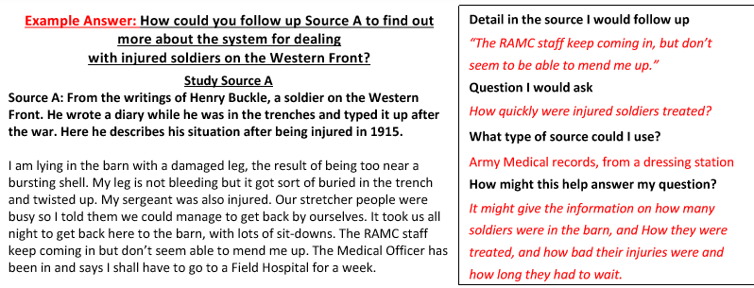
How would I answer the exam questions?

Slide 21
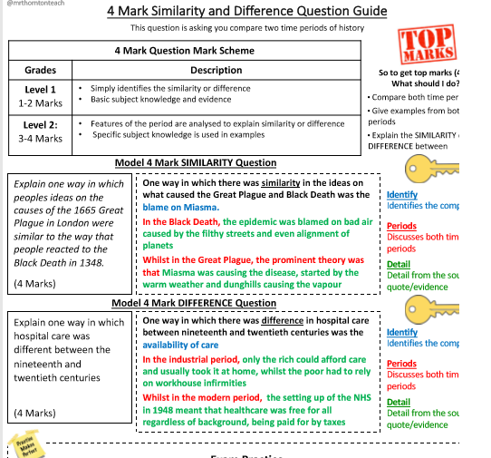
How would I answer the exam questions?
Section B – Medicine through time.
The Medicine paper consists of two sections:
Section A (worth 16 marks) – The British sector of the Western Front, 1914-1918.
Section B (worth 36 marks) – Medicine through time.
The paper is 1 hour 15 minutes in total.

Slide 22

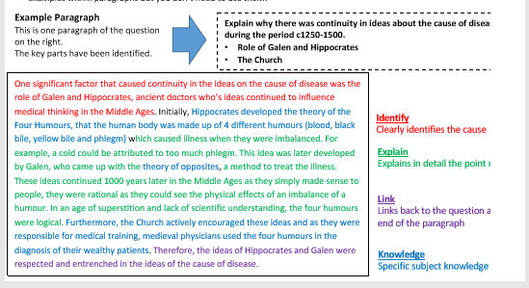
How would I answer the exam questions?

Slide 23

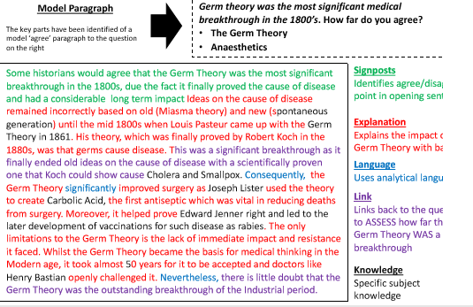
How would I answer the exam questions?

Slide 24


Wider reading and resources.
Something to watch…
How to answer the exam questions
https://www.youtube.com/watch?v=T4KM-nNFnHI
Medieval medicine https://www.youtube.com/watch?v=A-go7wPRb2A
Renaissance medicine https://www.youtube.com/watch?v=-SVek1hYgGU
Industrial medicine
https://www.youtube.com/watch?v=b5c5O3OAdFM
Modern medicine https://www.youtube.com/watch?v=my14ZuzjH5I
The British Sector on the Western Front https://www.youtube.com/watch?v=iqehK_WpaLo
Something to read…
Medieval Medicine: Its Mysteries and Science by Toni Mount
Renaissance Medicine by Nicola Barber
Joseph Lister: Father of Modern Surgery by Rhoda Truax
The rise and fall of modern medicine by Dr James Le Fanu
Mud, Blood and Bullets: Memoirs of a Machine Gunner on the Western Front by Edward Rowbottom.

